Slide 1

A Crowd-Powered
Conversational Assistant
That Automates Itself Over Time
Lecturer: Kenneth Huang
Pennsylvania State University
txh710@psu.edu
Mar 26, 2019

Slide 2
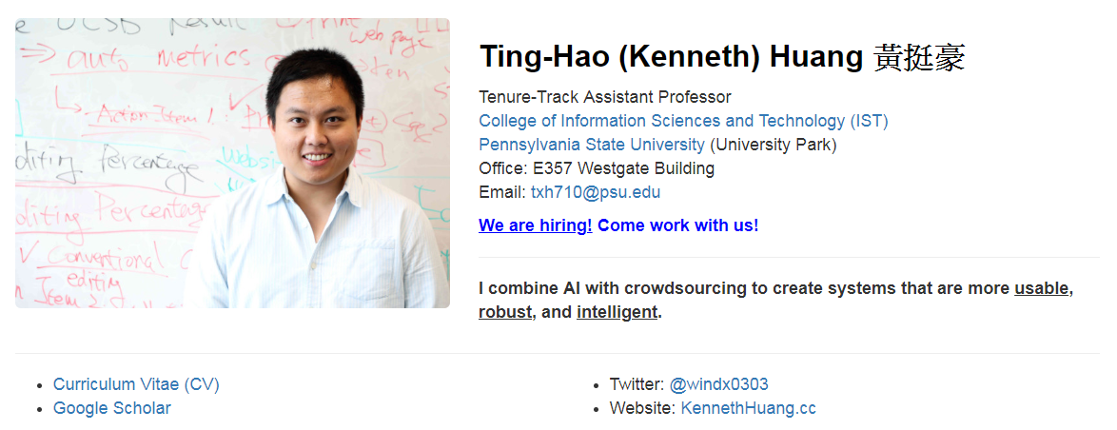


About Me
@windx0303
KennethHuang.cc

Slide 3
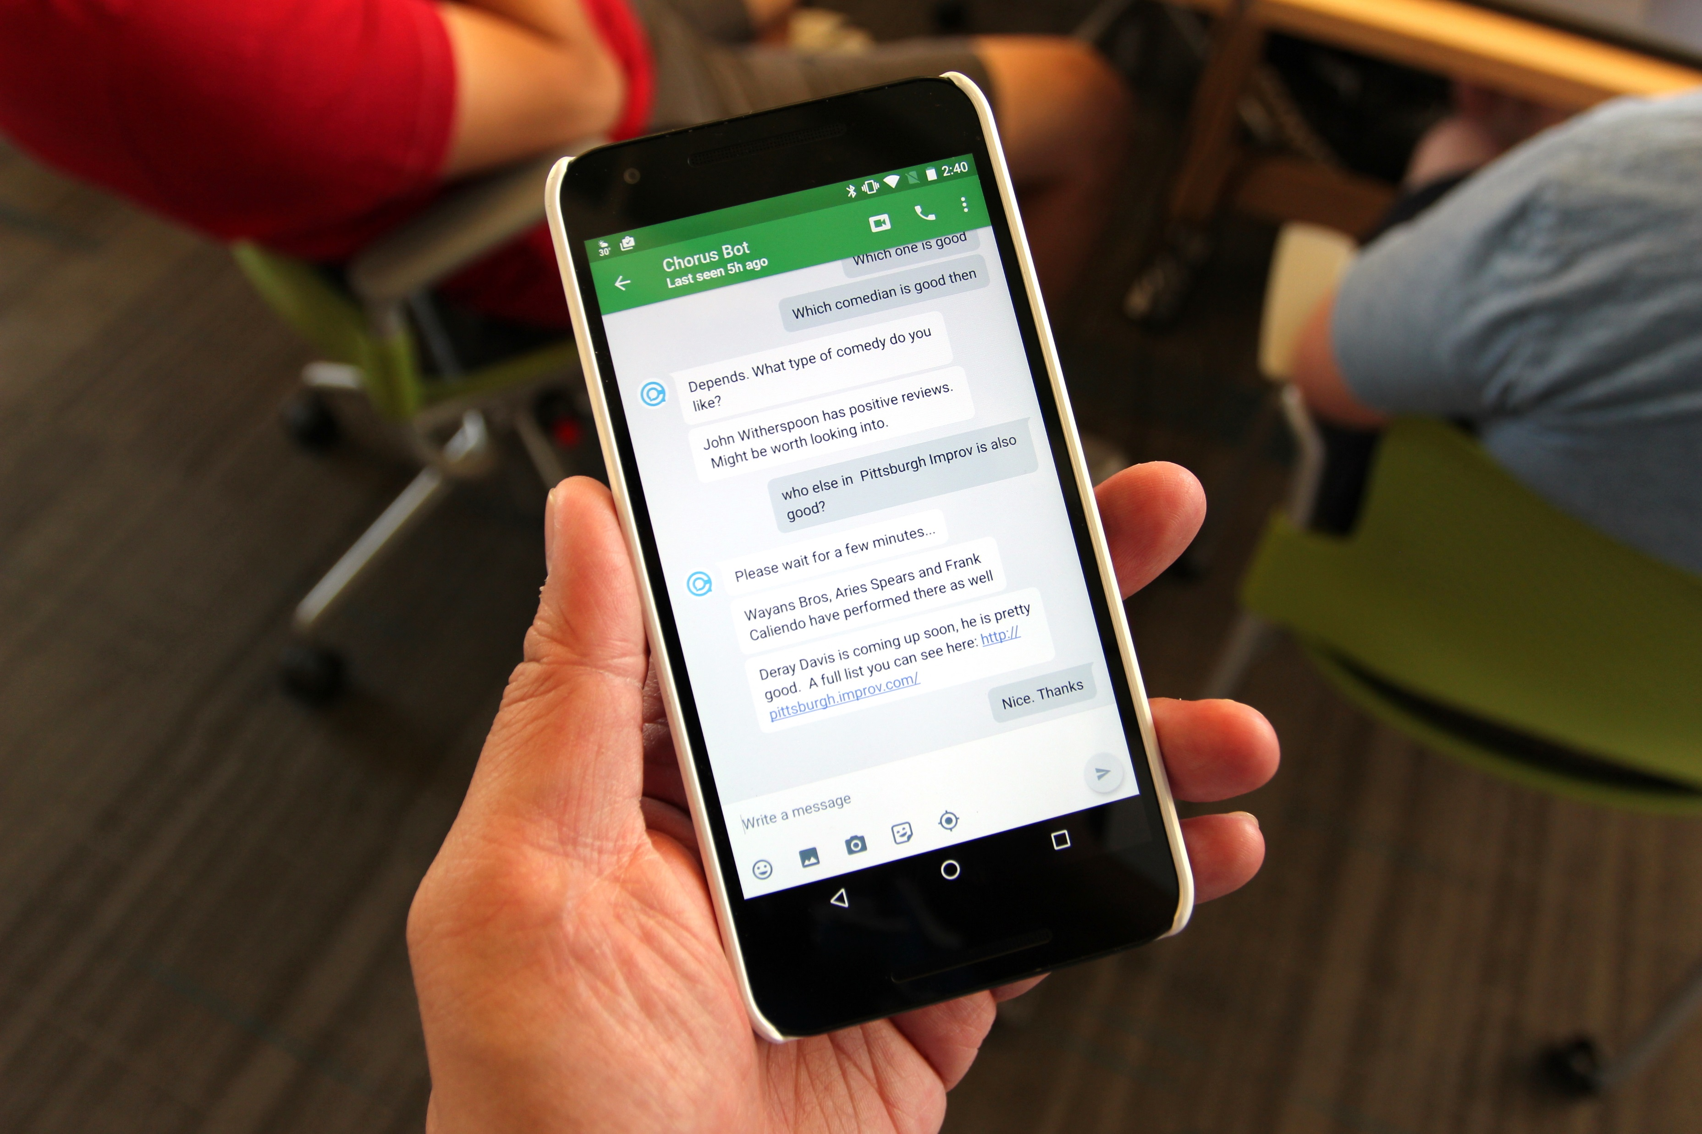


A Crowd-Powered Conversation Assistant
Chorus
CHI’18 , CHI LBW’16
UIST’17, UIST Poster’17
HCOMP’17, ‘16, ‘15, HCOMP DC’16, HCOMP WIP’14
CI’17
CSCW Workshop'17
Notes:
Use this for setup

Slide 4
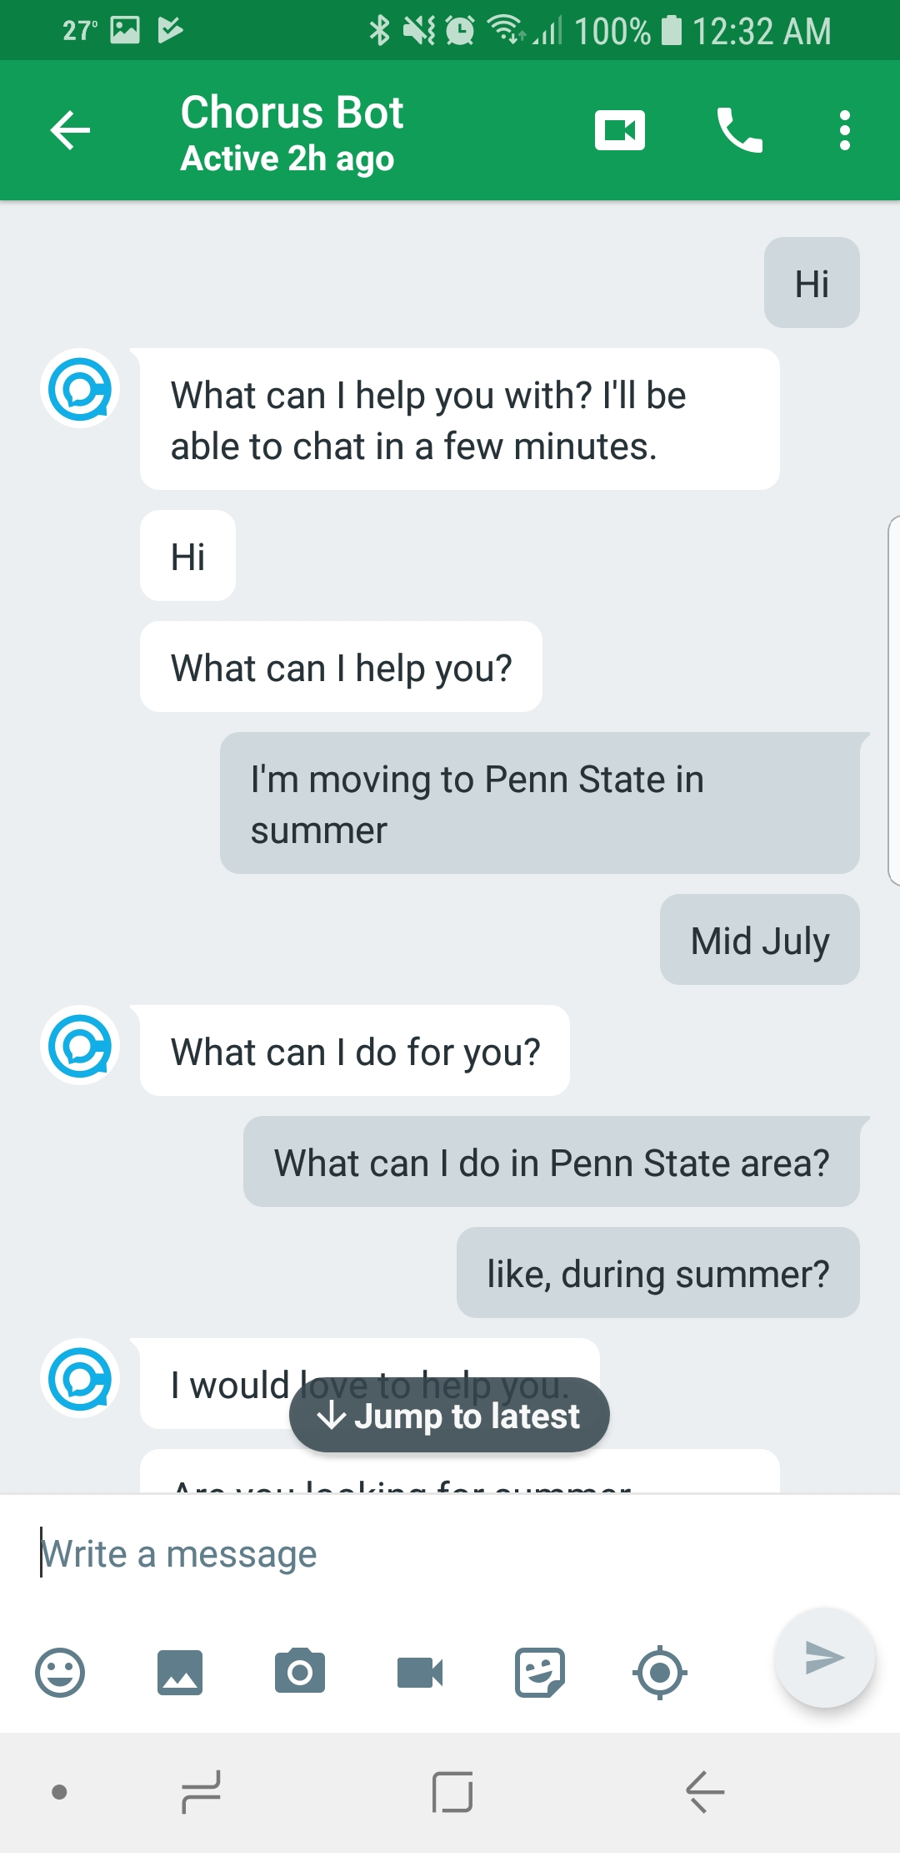

Slide 5
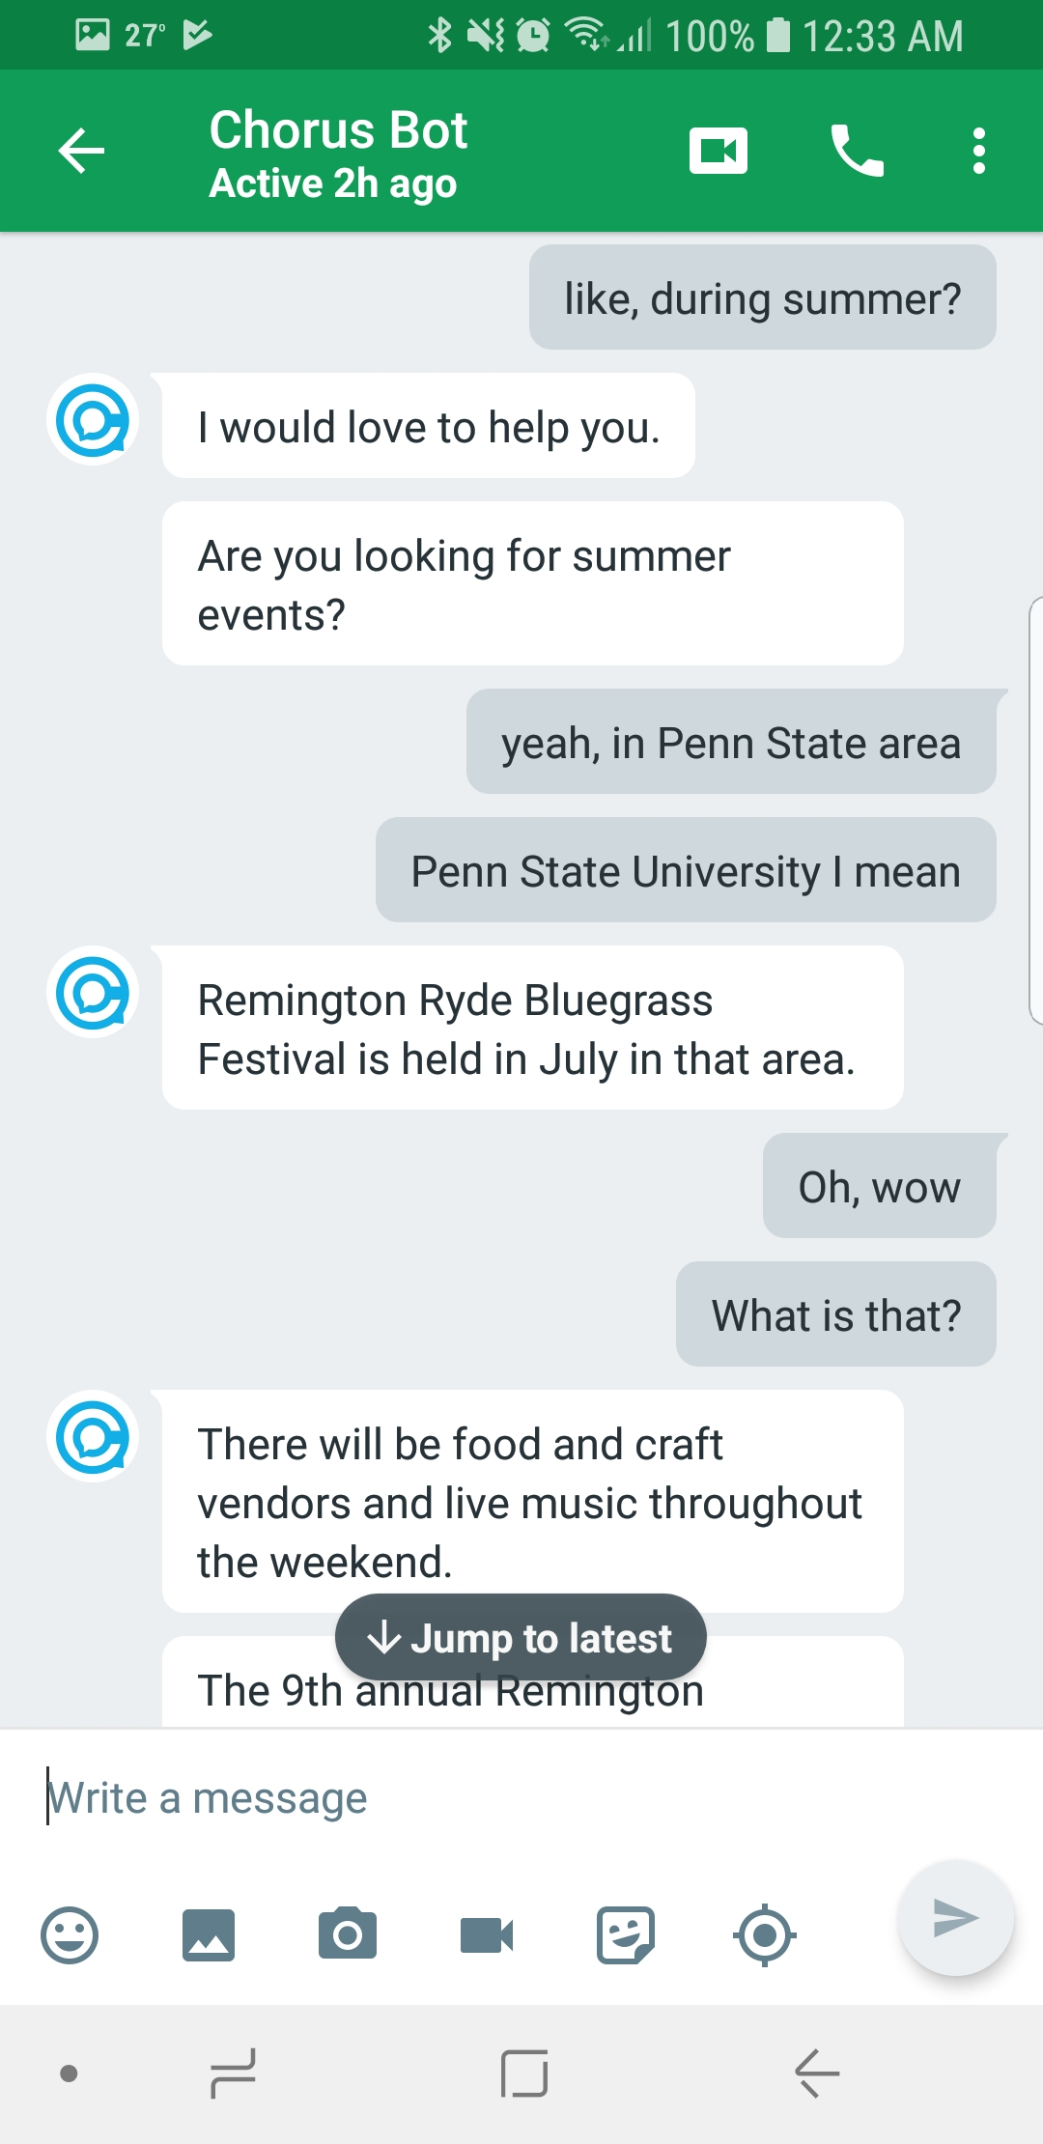
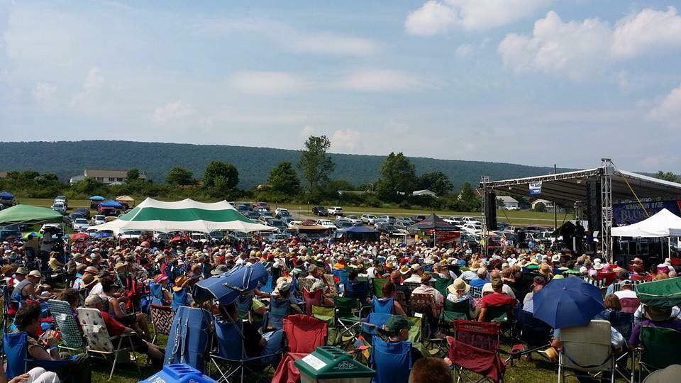

Slide 6
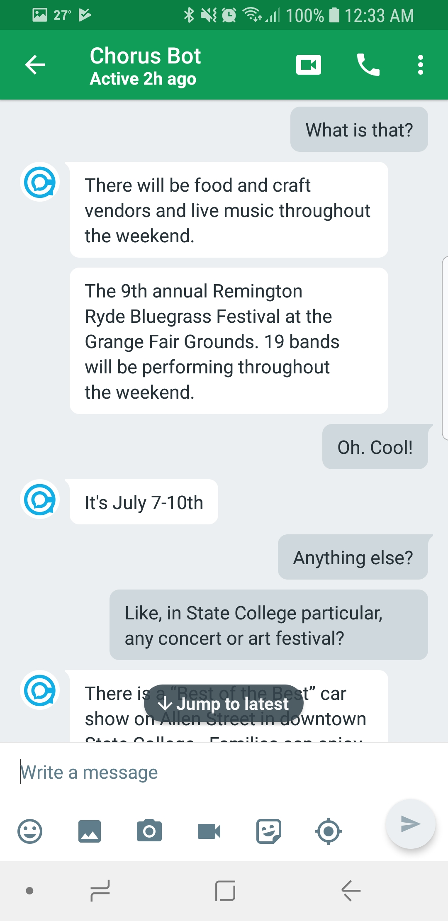

Slide 7
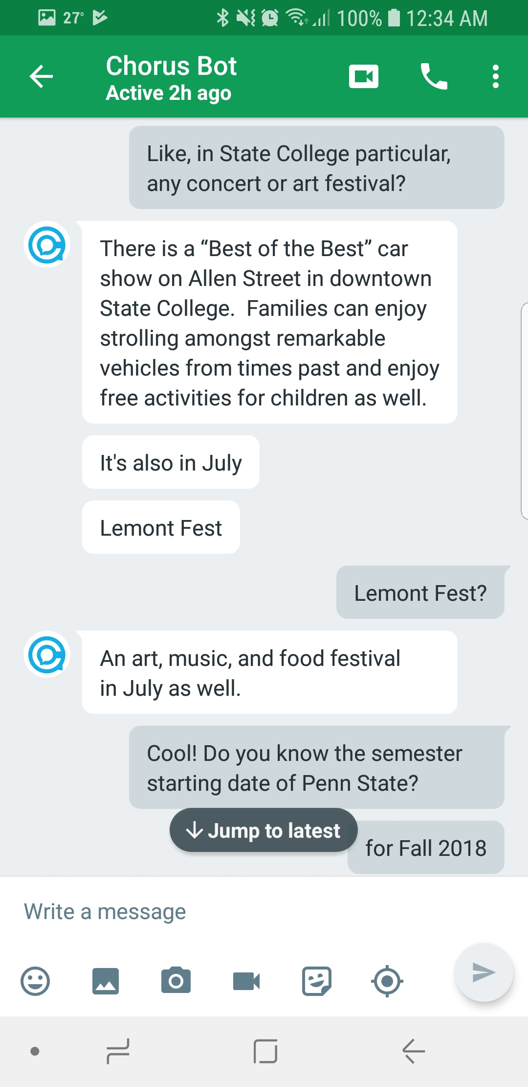

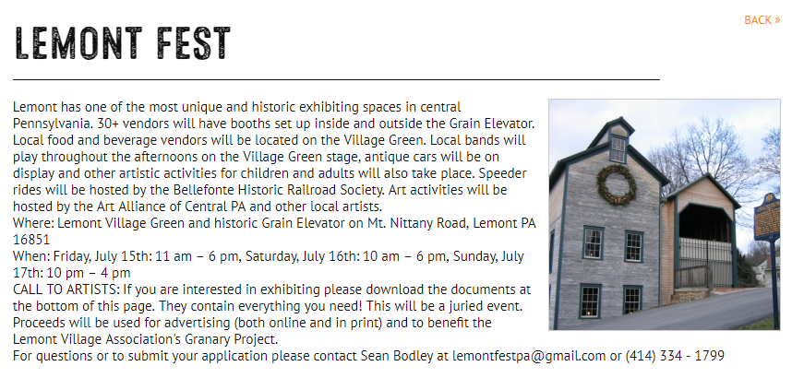

Slide 8
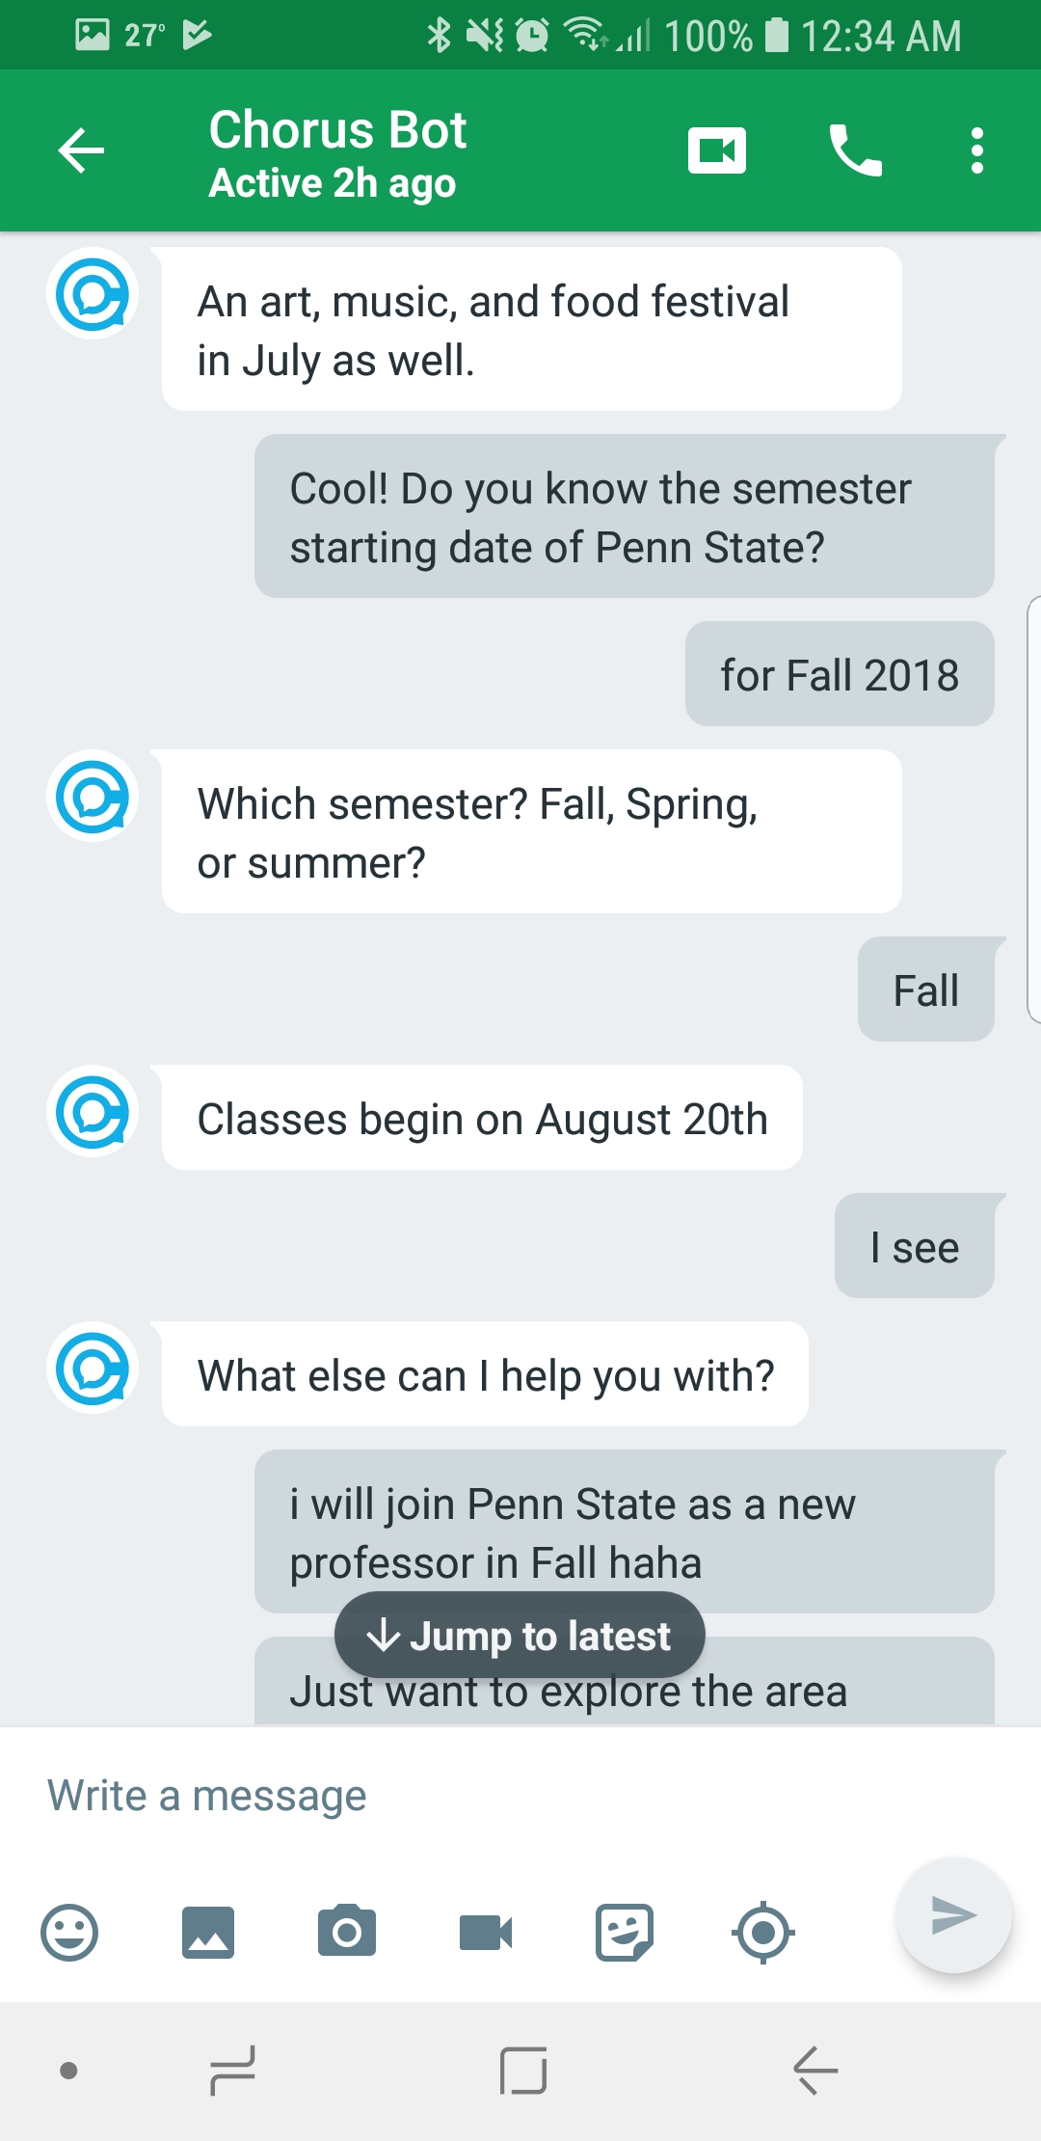

Slide 9
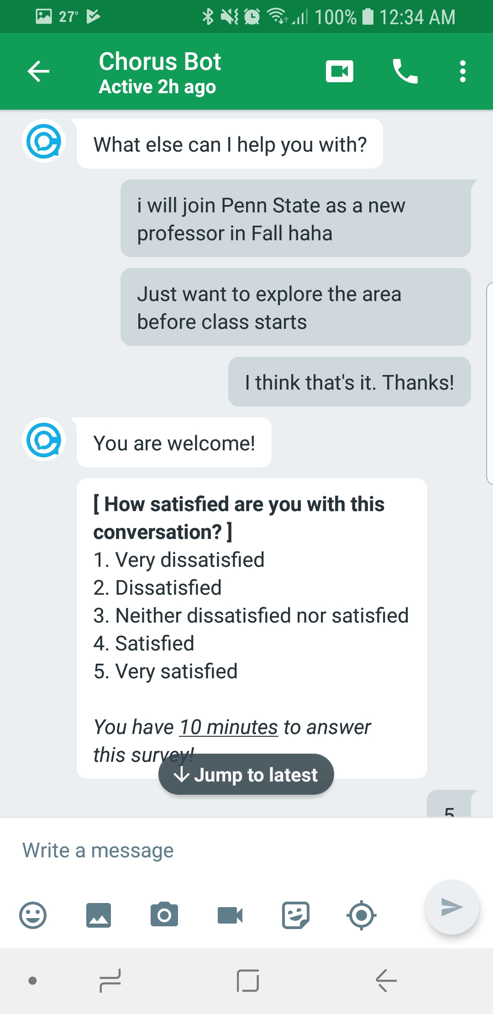

Slide 10
What just happened?
Open Conversation
Multi-turn interaction
Multiple domains
Personalized
Coherent dialog
Mix of task-oriented and social conversation
Notes:
Use this for setup

Slide 11
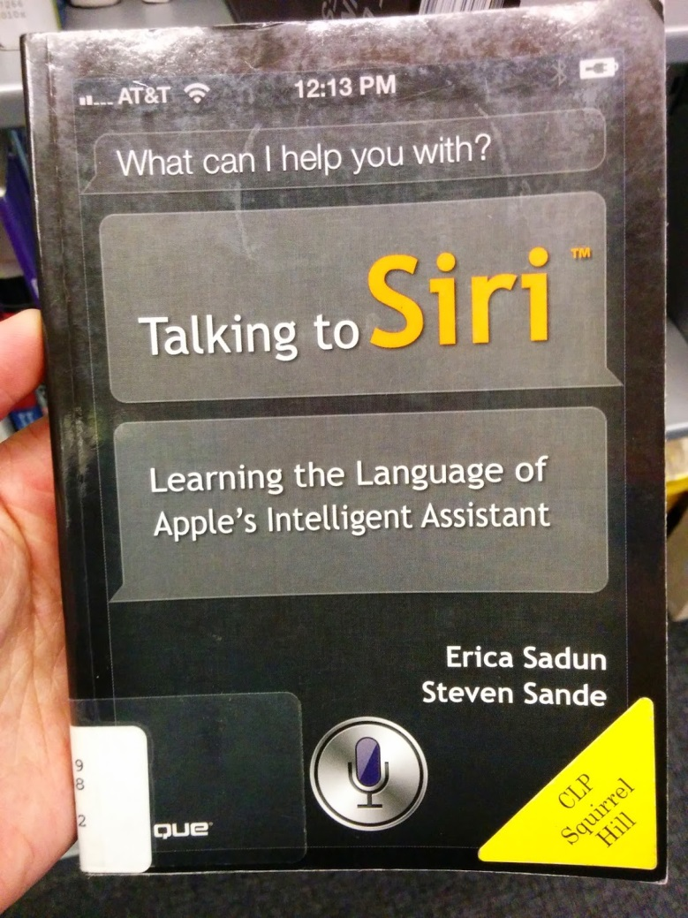
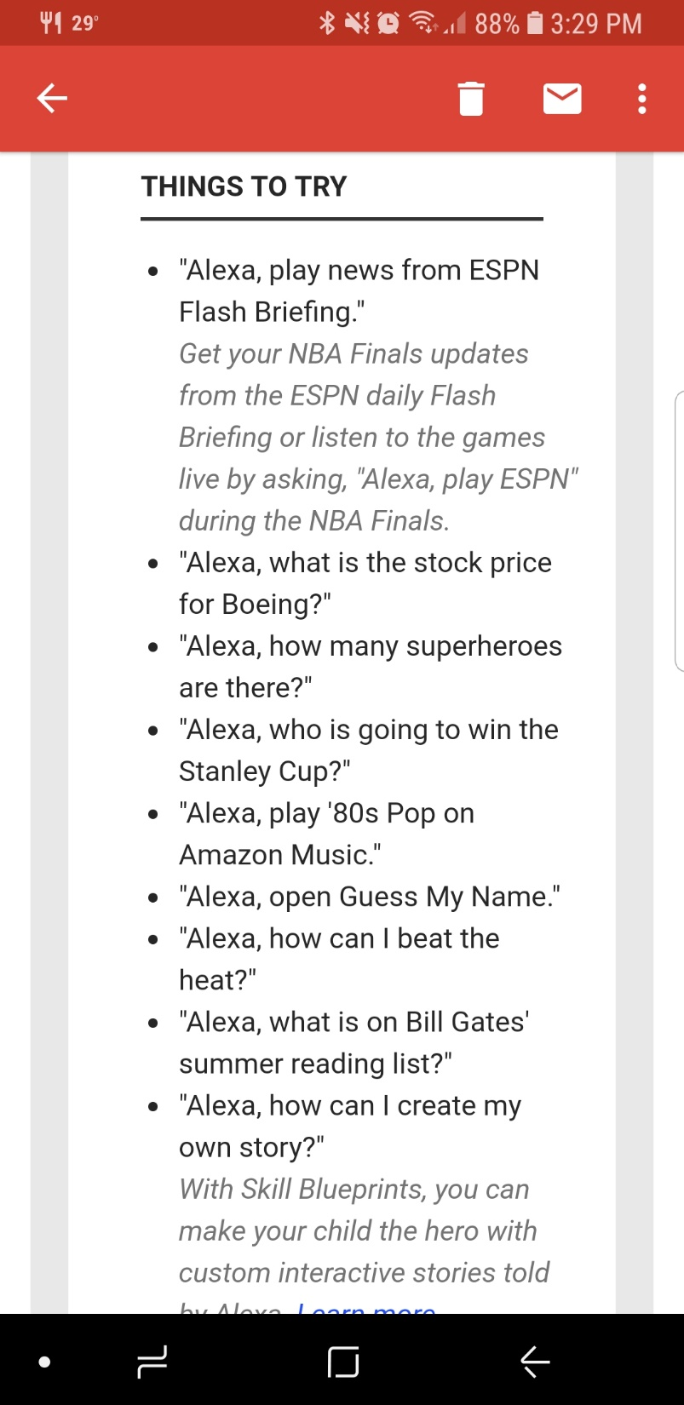
Today’s Conversational Assistants…
“Talking to Siri”
“What’s new
with Alexa?”
Notes:
Move to front

Slide 12
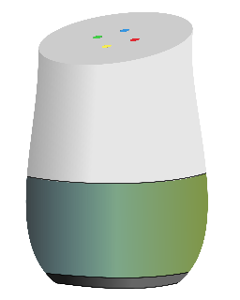

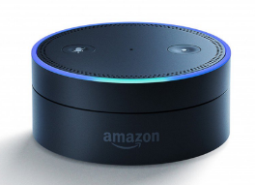
Automated
Personal
Assistants
Open Conversation

Slide 13
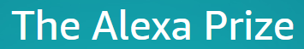
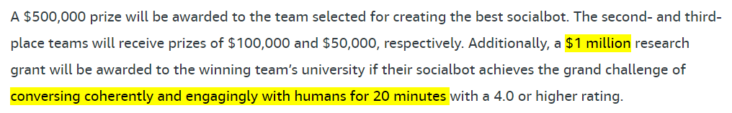
Existing Approaches to Open Conversation
Combining multiple automated dialog systems
DialPort (Zhao, et al., 2016)
End-to-end framework for dialogue systems
Serban, et al. 2016; Li, et al. 2017
Adapting a model to many other domains
Walker, et al., 2007; Sun, et al., 2016
Chit-chat systems (social bot)
Hold social conversations (Banchs, et al., 2012)
Still a very hard problem…

Slide 14
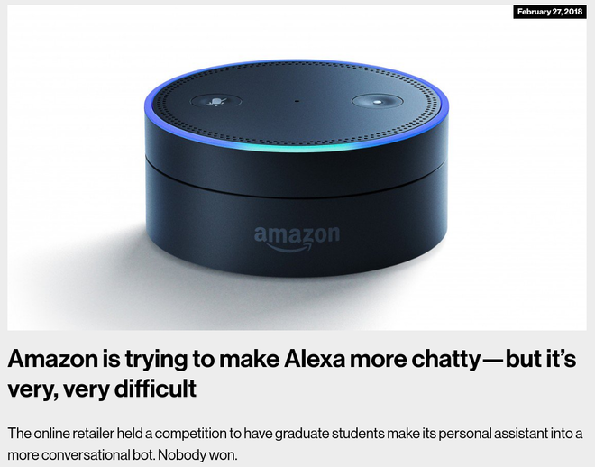
Existing Approaches to Open Conversation
Combining multiple task-oriented dialog systems
DialPort (Zhao, et al., 2016)
End-to-end framework for dialogue systems
Serban, et al. 2016; Li, et al. 2017
Adapting a model to many other domains
Walker, et al., 2007; Sun, et al., 2016
Chit-chat systems (social bot)
Hold social conversations (Banchs, et al., 2012)
Still a very hard problem…
MIT Technology Review
Feb 27, 2018

Slide 15



Automated
AI-Powered Dialog Systems
Personal
Assistants
Open Conversation

Slide 16
Automated
AI-Powered Dialog Systems
Personal
Assistants
Open Conversation

Slide 17

Automated
AI-Powered Dialog Systems
Personal
Assistants
Crowd-Powered
Dialog Systems
Open Conversation

Slide 18
Automated
AI-Powered Dialog Systems
Personal
Assistants
Crowd-Powered
Dialog Systems
Open Conversation

Slide 19
Automated
AI-Powered Dialog Systems
Personal
Assistants
Kenneth’s Thesis!
Crowd-Powered
Dialog Systems
Open Conversation

Slide 20
Automated
AI-Powered Dialog Systems
Personal
Assistants
Crowd-Powered
Dialog Systems
Open Conversation

Slide 21
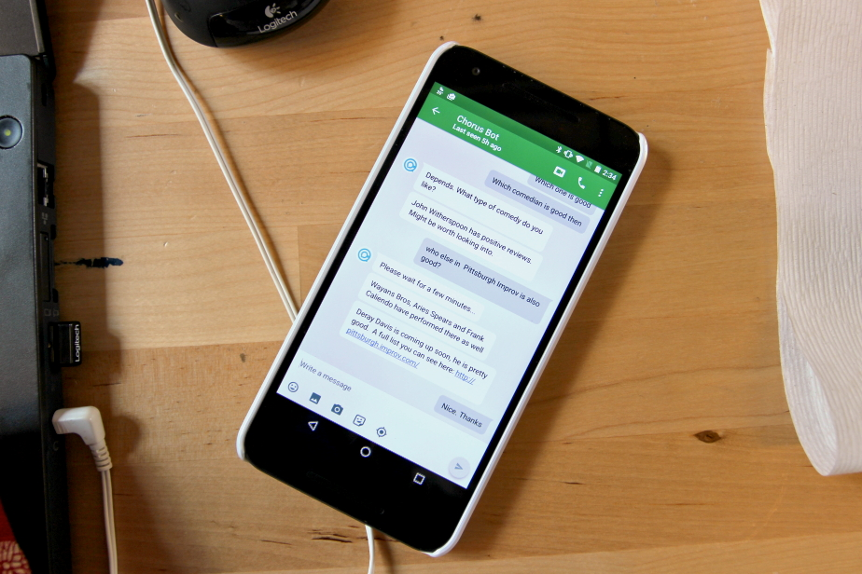
Chorus: A Crowd-Powered Conversation Assistant [ HCOMP’16, HCOMP’17 ]
Notes:
We introduce the new approach to open conversation

Slide 22
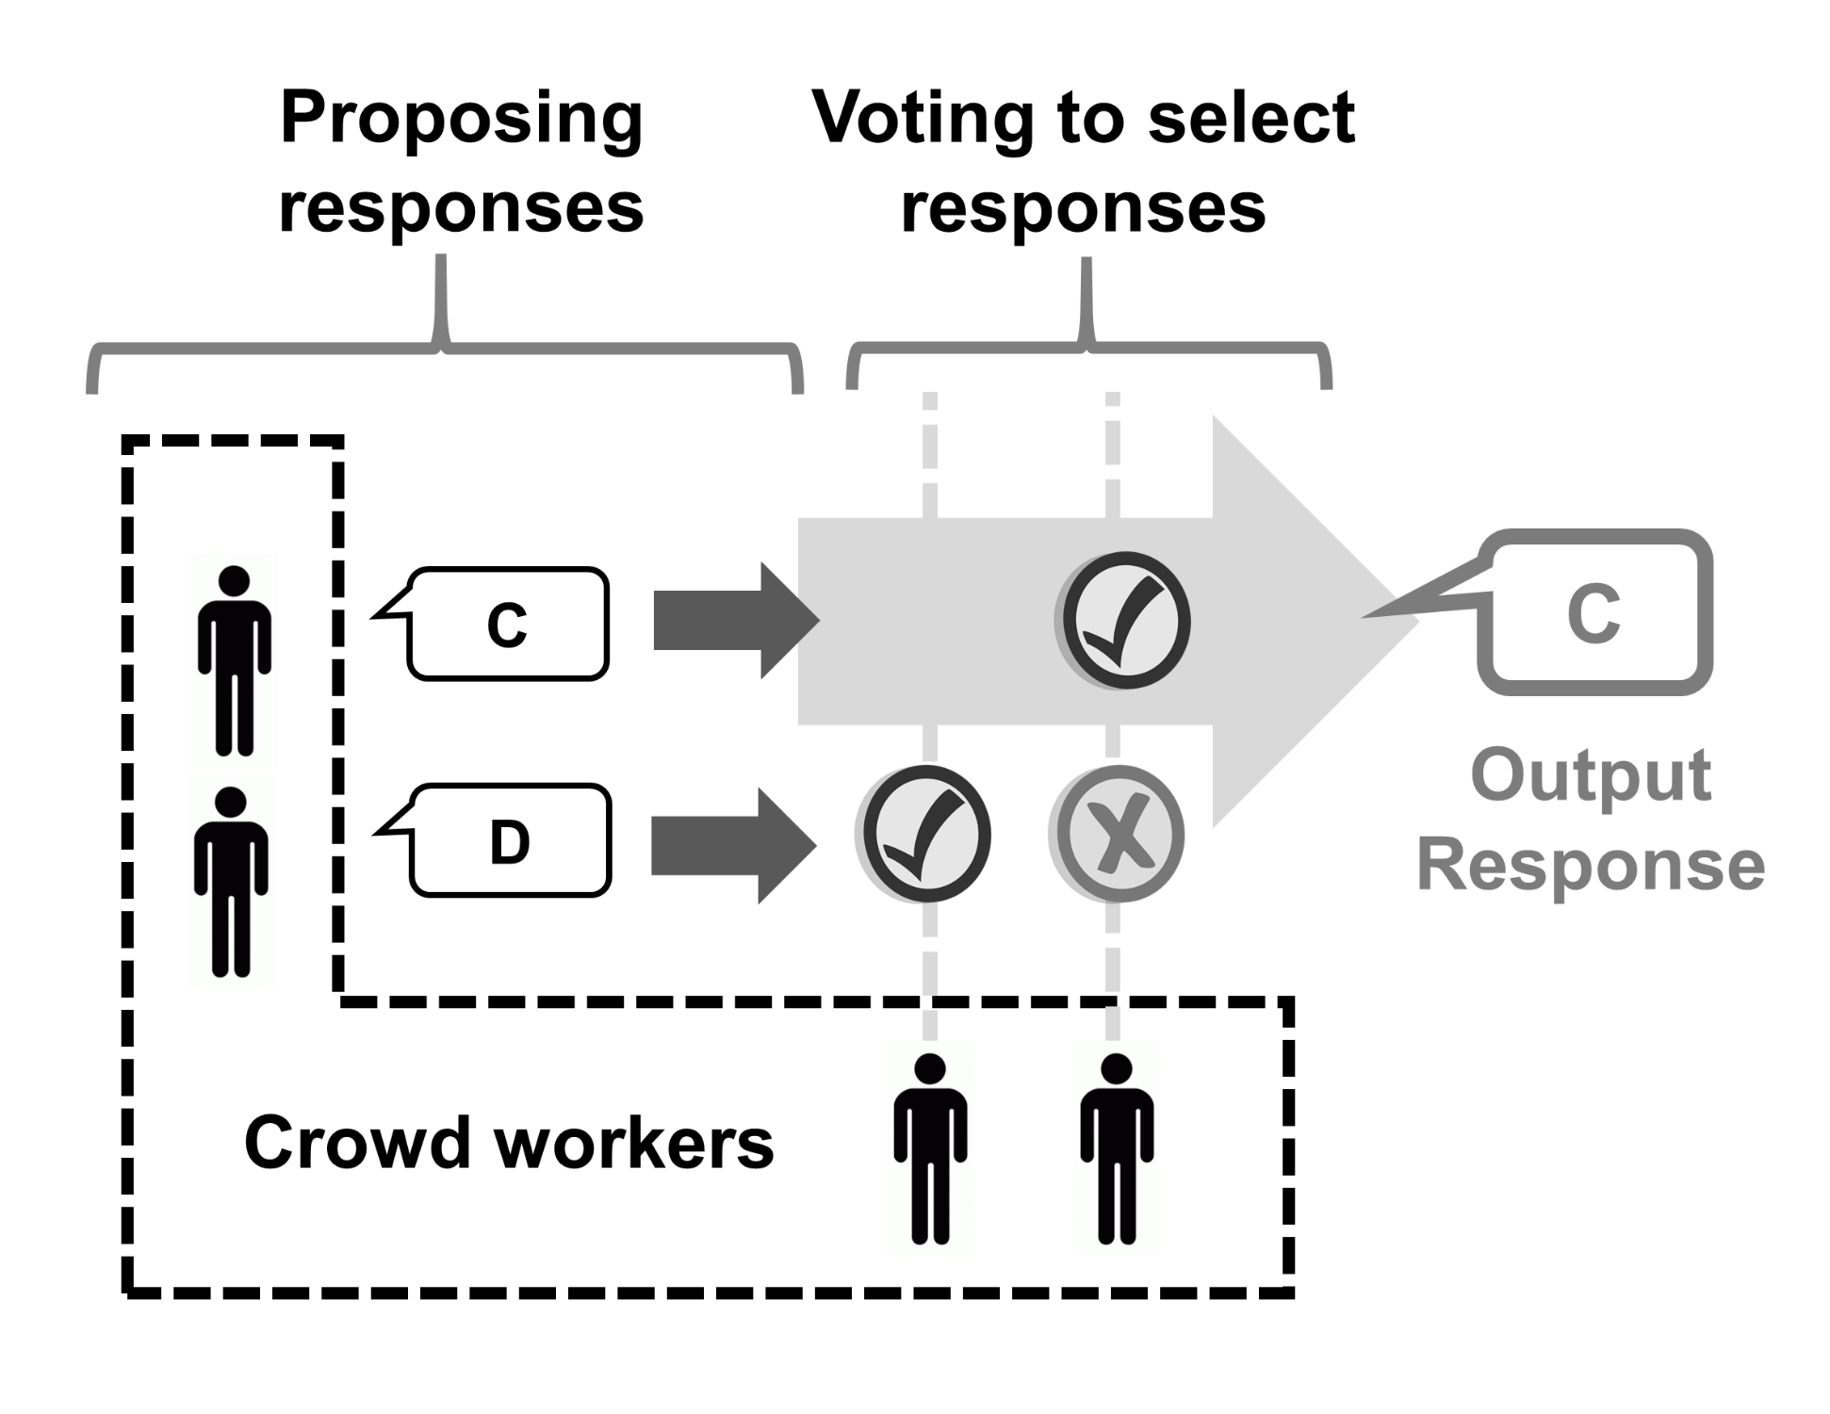
Chorus: A Crowd-Powered Conversation Assistant
Crowd workers collectively hold a conversation by:
Propose Responses
Vote Responses
Take Notes
Reward points for each action
Agreement bonus
Chorus: A Crowd-Powered Conversational Assistant Lasecki, et al. UIST’13.
Notes:
Say some challenges of crowdsourcing system
Keep context
Malicious / Lazy workers

Slide 23
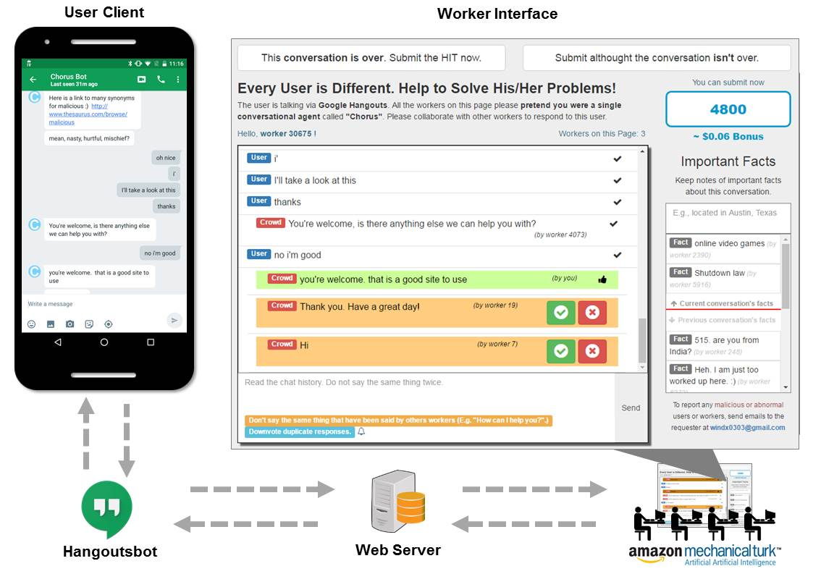
User Interface

Slide 24
User & Worker Interface

Slide 25
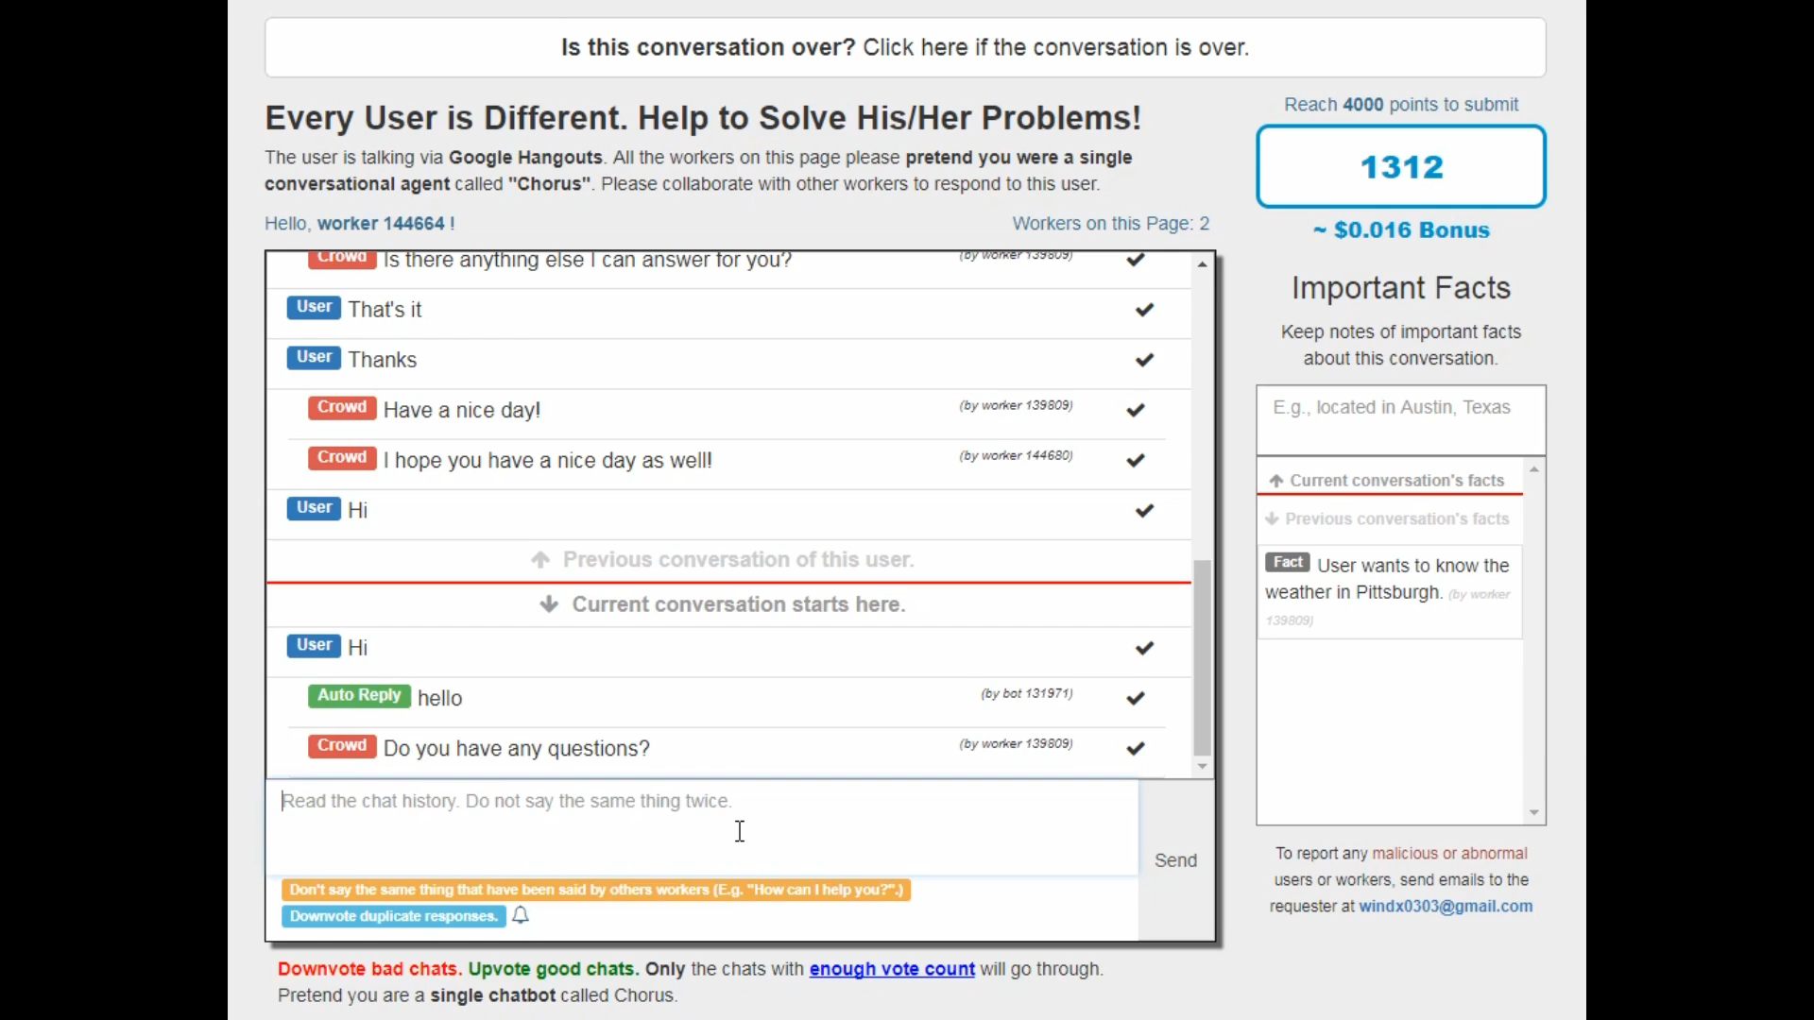

Slide 26
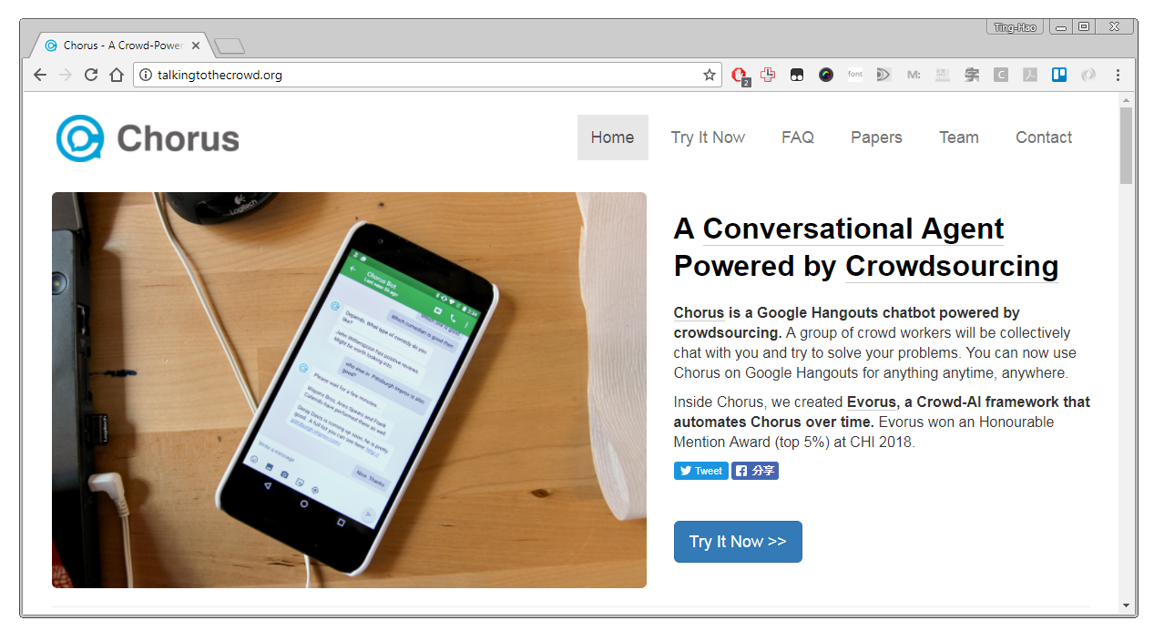
We Deployed Chorus
Launched on May 20th, 2016
On Google Hangouts
2200+ conversations, 420+ users
TalkingToTheCrowd.org

Slide 27

Can you suggest some birthday present for one of my friend?
Gift
Suggestion
U
female, computer science PhD student in Texas
Sure! What types of things does your friend like?
we're going to visit her this weekend from Pittsburgh
U
She's in Austin
Does she have any favorite TV shows, movies, or video games?
Notes:
Dino-shape clear container
living tiny organisms
glow blue in dark

Slide 28

Can you suggest some birthday present for one of my friend?
Gift
Suggestion
U
female, computer science PhD student in Texas
Sure! What types of things does your friend like?
we're going to visit her this weekend from Pittsburgh
U
She's in Austin
Does she have any favorite TV shows, movies, or video games?
Notes:
Dino-shape clear container
living tiny organisms
glow blue in dark

Slide 29

Can you suggest some birthday present for one of my friend?
Gift
Suggestion
U
female, computer science PhD student in Texas
Sure! What types of things does your friend like?
we're going to visit her this weekend from Pittsburgh
U
She's in Austin
Does she have any favorite TV shows, movies, or video games?
Notes:
Dino-shape clear container
living tiny organisms
glow blue in dark

Slide 30
Travel
Planning
How many suitcases can I take on a flight from the US to Israel?
U
Let me check
Can I ask you from where are you planning to board the flight?
Pittsburgh
U
with which company are you flying?
and which air services are you using?
Full transcript: Huang, et al. HCOMP 2016.

Slide 31
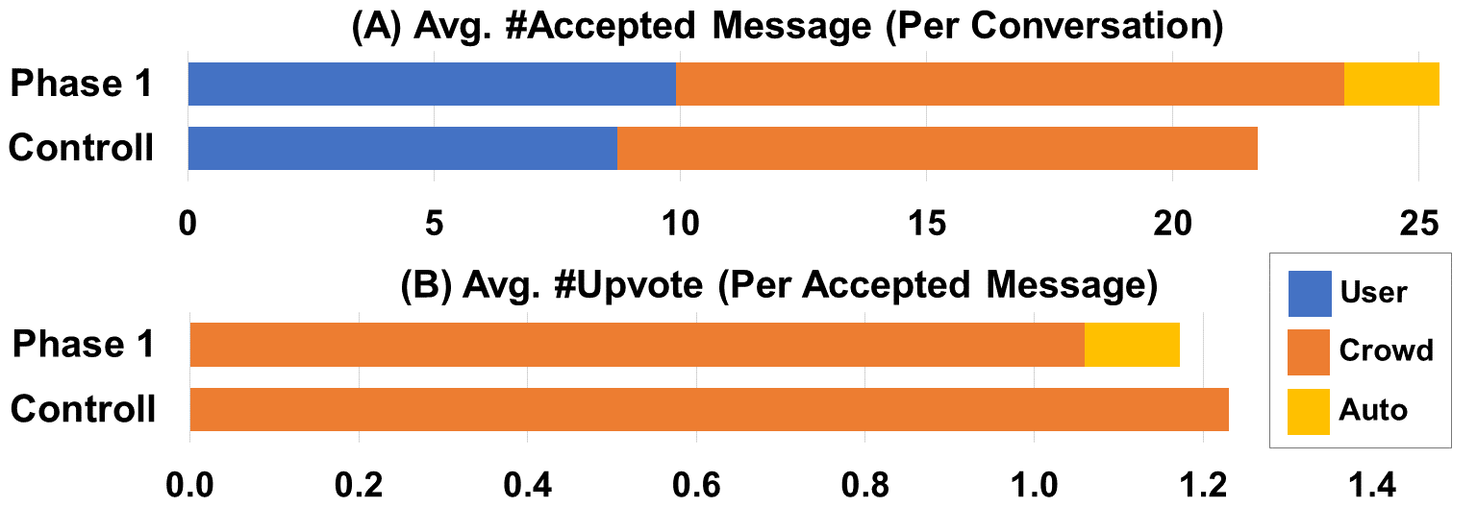
What Did We Learn?
Challenges Identified
Malicious workers & users
Identifying the end of a conversation
When workers’ consensus is not enough…
Basic Statistics
Avg session duration = 10.63 min (SD=8.38)
Avg #message per session = 25.87 (SD= 27.27)
Foundation for future automation!
Avg. #Upvote / Msg
Notes:
“Feasible” is weird. Maybe something else?

Slide 32
Automated
AI-Powered Dialog Systems
Personal
Assistants
Chorus Deployment
[ HCOMP’16, HCOMP’17 ]
Crowd-Powered
Dialog Systems
Open Conversation

Slide 33
Automated
AI-Powered Dialog Systems
Personal
Assistants
Chorus Deployment
[ HCOMP’16, HCOMP’17 ]
Crowd-Powered
Dialog Systems
Open Conversation

Slide 34
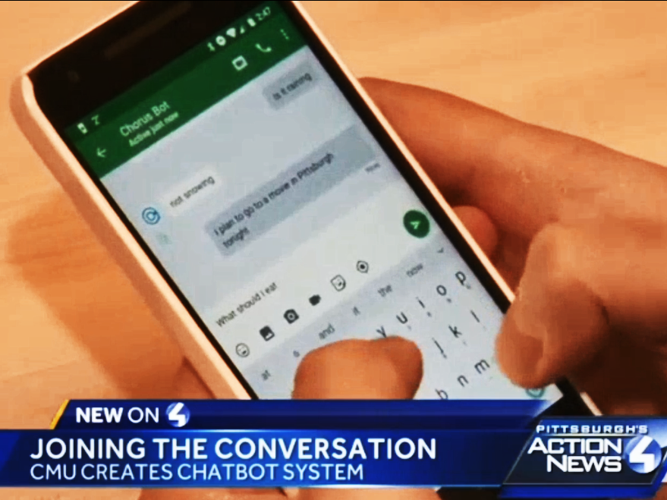

Evorus: A Crowd-Powered Conversational Assistant Built to Automate Itself Over Time [ UIST Poster’17, CHI’18 ]
Notes:
Telling a story

Slide 35

Automating Chorus Over Time

Slide 36
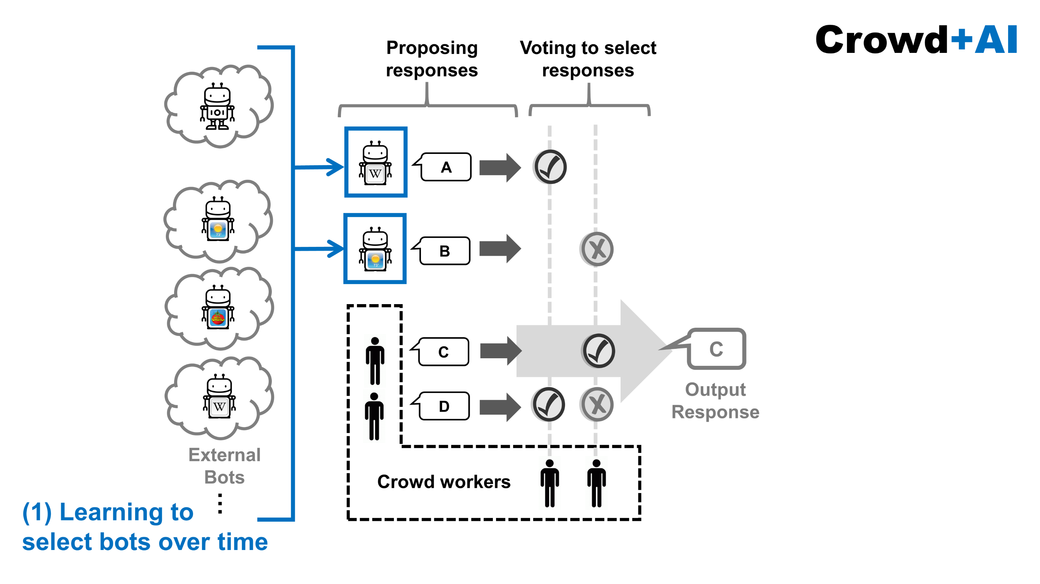
Automating Chorus Over Time
Notes:
The key point of this part is that each chatbot doesn’t need to be perfect

Slide 37
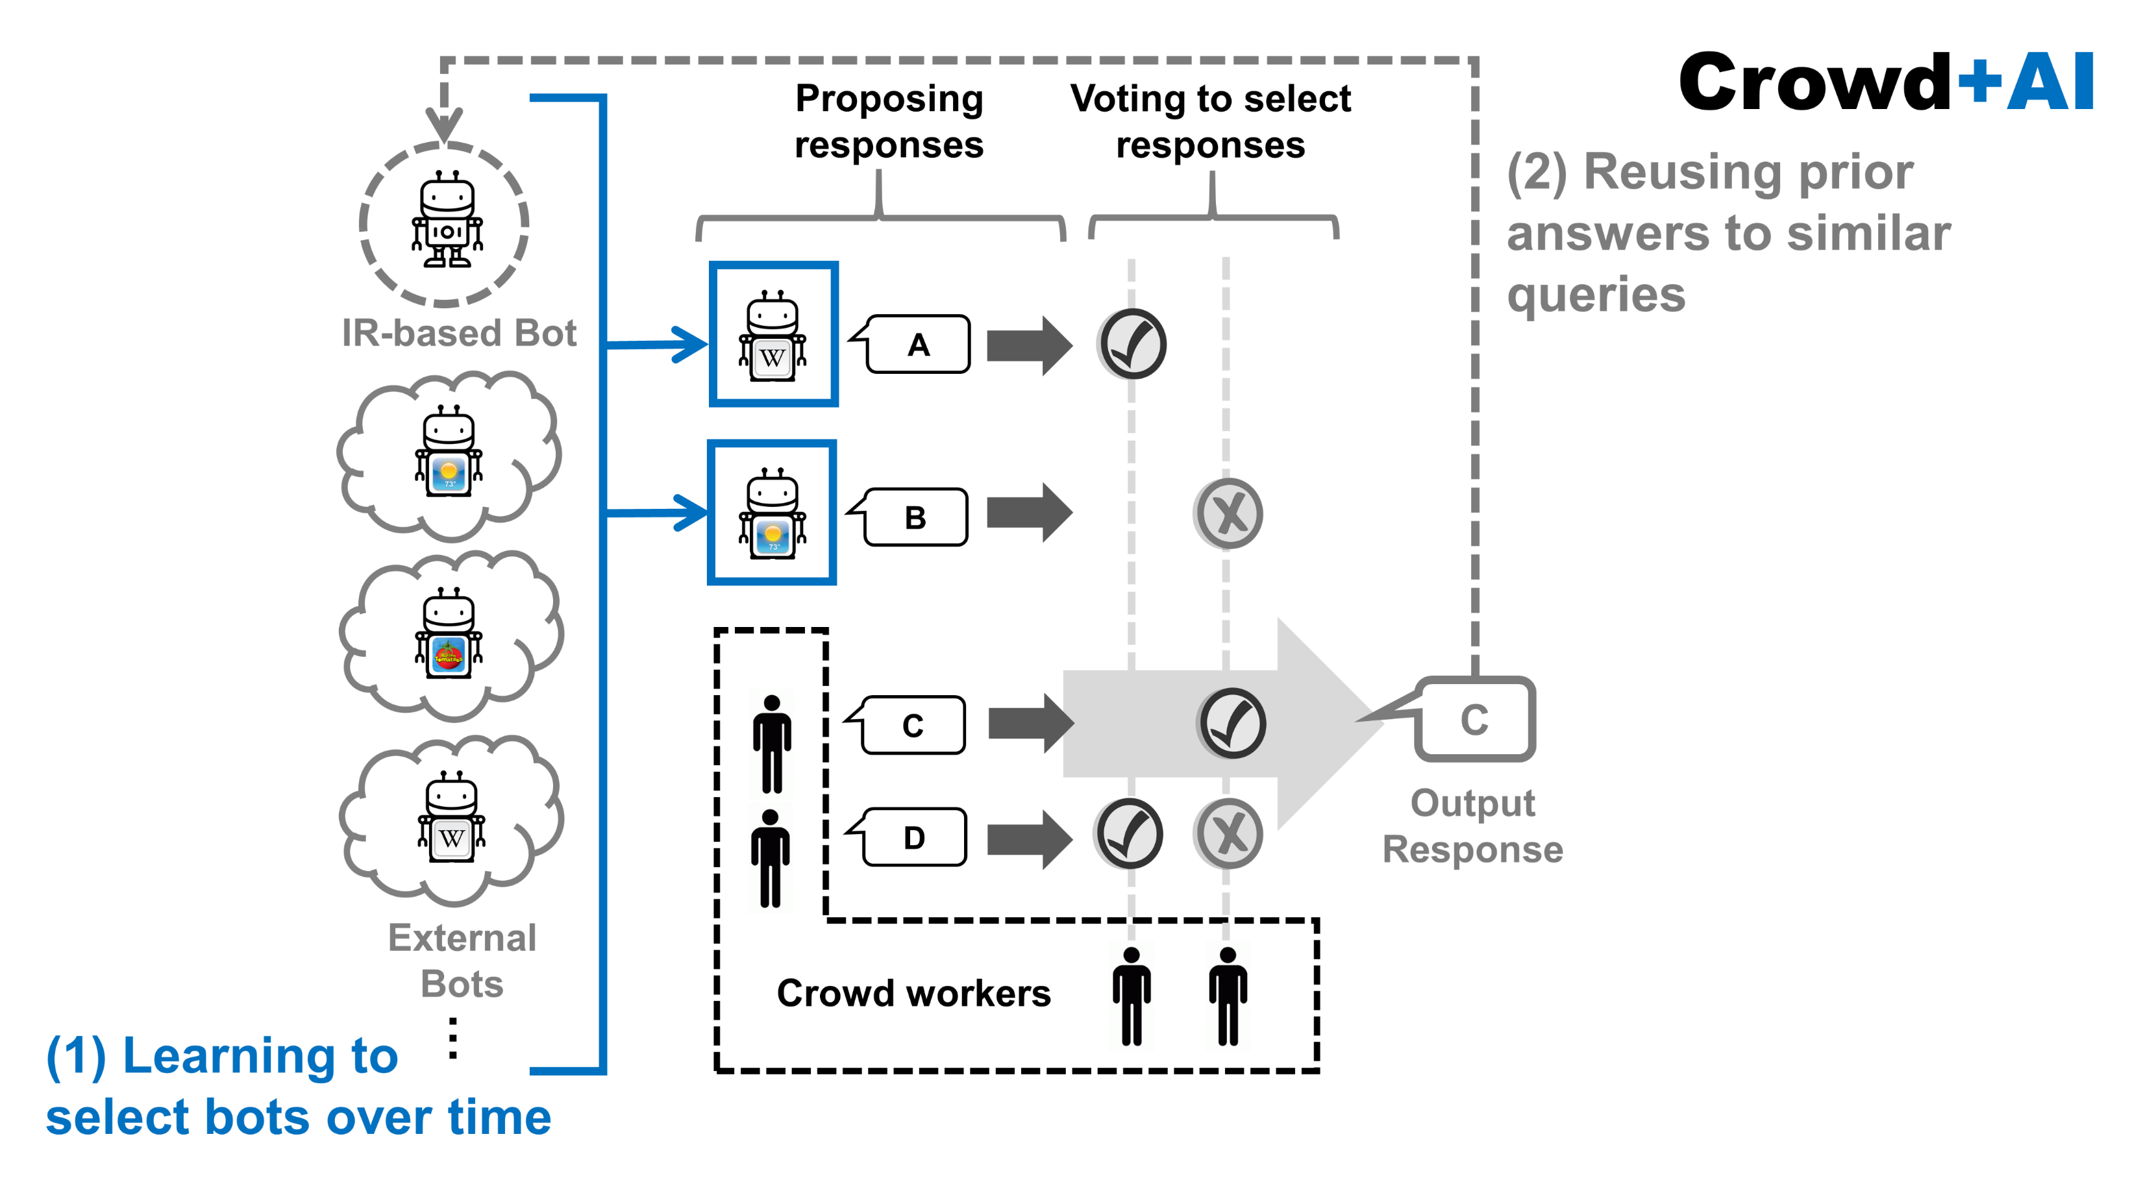
Automating Chorus Over Time

Slide 38
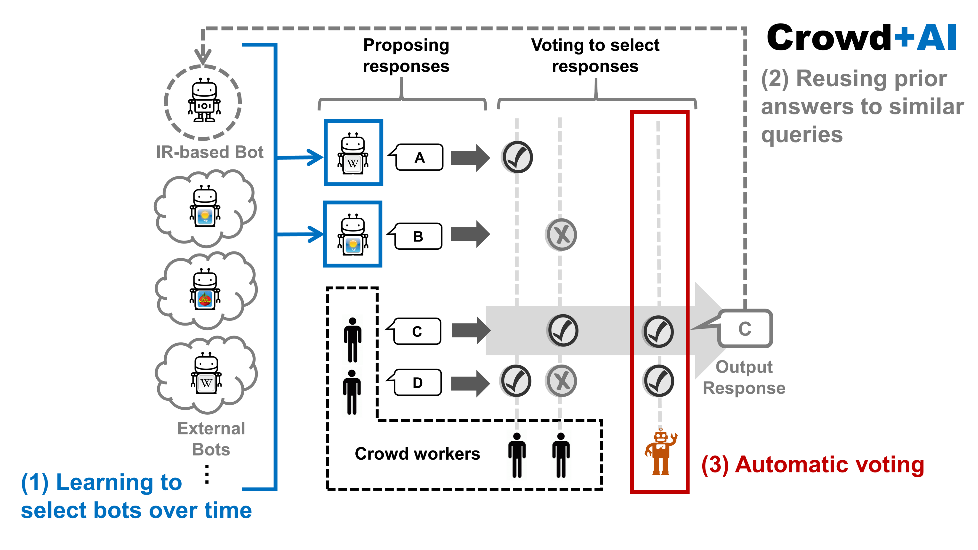
Automating Chorus Over Time
Notes:
If your think this it too abstract, we have a more concrete visulizaiton:

Slide 39
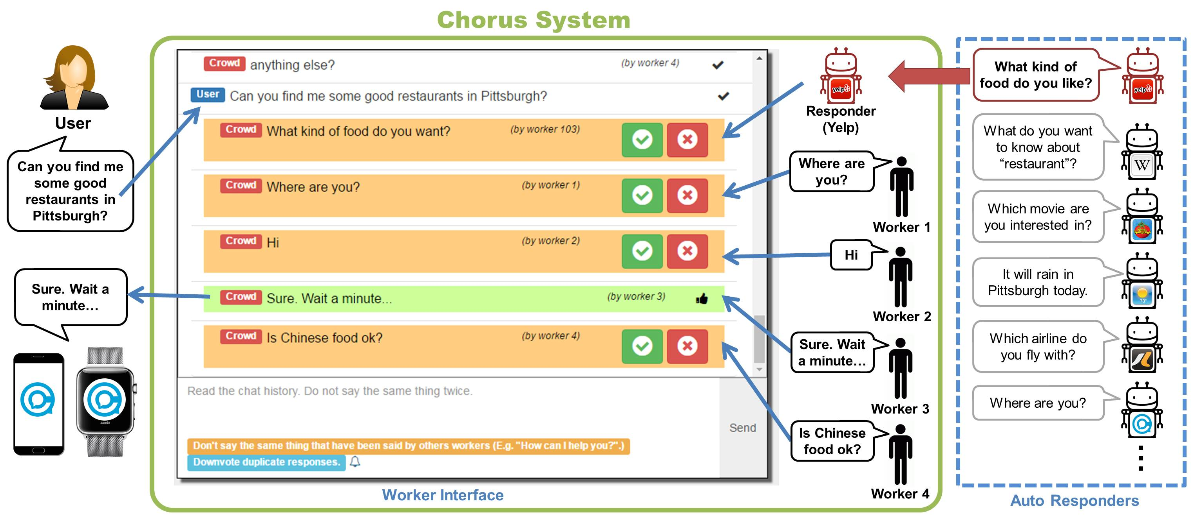
Empower Chorus with Multiple Chatbots
Notes:
Let’s first take a look at the overview of the automation.
The way we are going to automate Chorus is to have Chorus incorperate with a big set of external dialog systesm, and gradually learn when to call them to obtain responses.
For instacne, (Yelp example)

Slide 40
Chatbots
How to select chatbots automatically?

Slide 41

Ranking Chatbots: Performance & Topic
$$≈$$
Posterior of a Chatbot
Chatbot’s Performance
Topic Similarity

Slide 42
Ranking Chatbots: Performance & Topic
$$≈$$
Posterior of a Chatbot
Chatbot’s Performance
Topic Similarity
~= Overall Message Acceptance Rate

Slide 43
Ranking Chatbots: Performance & Topic
$$≈$$
Topic Similarity
User Message
Hey what should I eat in Montreal?
Domain of
the Chatbot

Slide 44

Ranking Chatbots: Performance & Topic
$$≈$$
Topic Similarity
User Message
Hey what should I eat in Montreal?
Domain of
the Chatbot
Find me some
good restaurants !
Example
Triggering
Message
Where can I get
Chinese food?

Slide 45
Ranking Chatbots: Performance & Topic
$$≈$$
Topic Similarity
User Message
Hey what should I eat in Montreal?
Domain of
the Chatbot
Topic
Similarity
Find me some
good restaurants !
Example
Triggering
Message
Where can I get
Chinese food?

Slide 46
Ranking Chatbots: Performance & Topic
$$≈$$
Posterior of a Chatbot
Chatbot’s Performance
Topic Similarity

Slide 47
Ranking Chatbots: Performance & Topic
$$≈$$
Posterior of a Chatbot
Update over time
Chatbot’s Performance
Topic Similarity
Update over time
Add more chatbots over time !

Slide 49
Automatic Upvote
How to estimate the impact of an automation?

Slide 50
Find the Best Confidence Threshold
High Threshold
Only vote when pretty sure
High precision, but little benefit
Low Threshold
Nearly always vote
Grant agreement bonus by mistake
Damage conversation quality

Slide 51
Automating Chorus Over Time
Notes:
Let’s first take a look at the overview of the automation.
The way we are going to automate Chorus is to have Chorus incorperate with a big set of external dialog systesm, and gradually learn when to call them to obtain responses.
For instacne, (Yelp example)

Slide 52
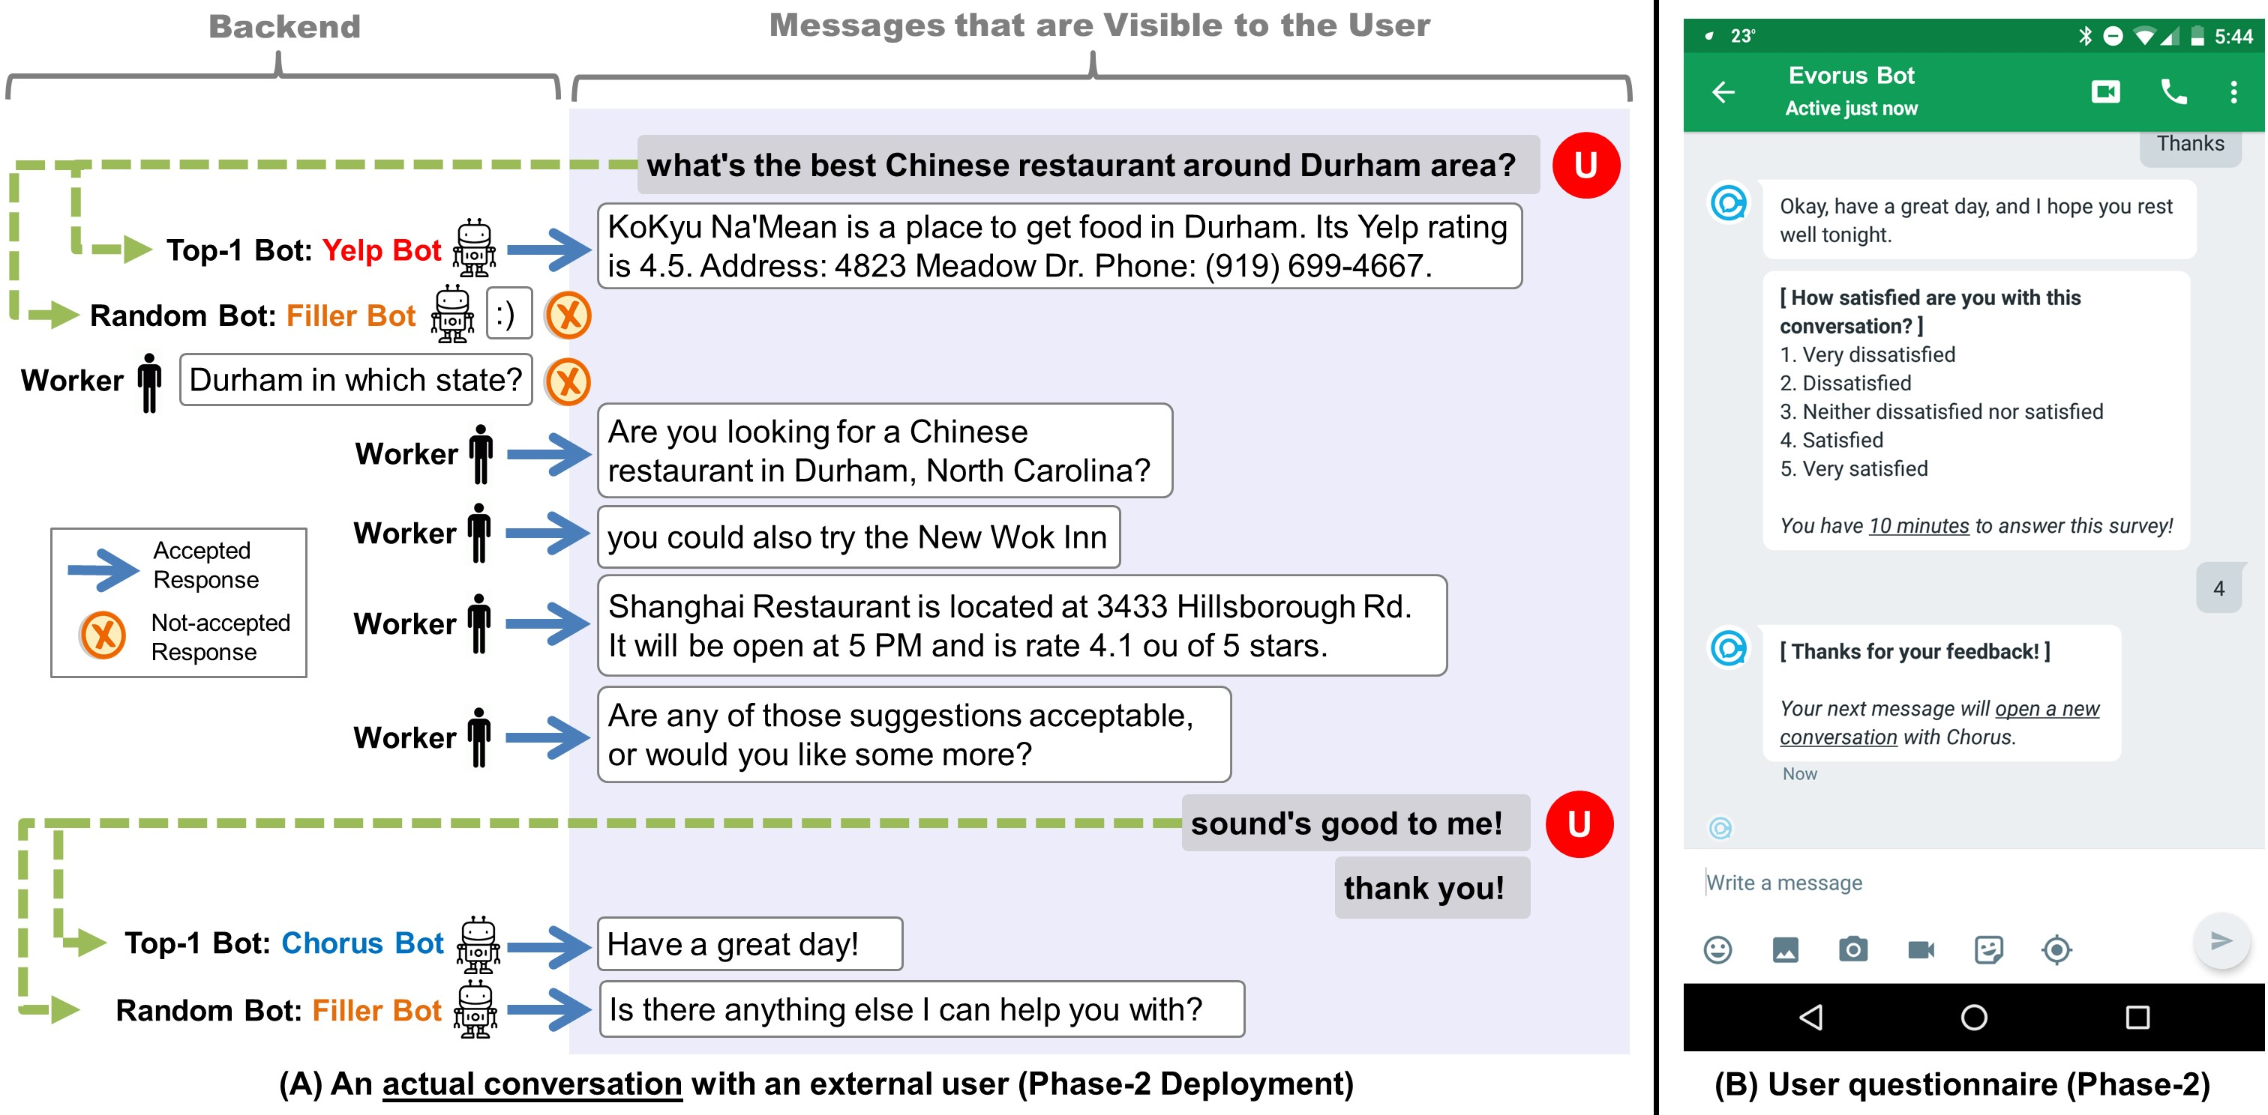
Automating Open Conversation
Setup
A 5-month-long deployment, 80 Users
4 chatbots + 1 voting bot
Result
Automated responses were chosen 12.44% of the time.
Human upvotes were reduced by 13.81%.
The cost of each message is reduced by 32.76%.
Conversation quality and user satisfaction level remains.
Conversation Quality: Satisfaction, Clarity, Responsiveness, Comfort (Liu, et al., 2010)
Crowd + AI
Crowd
Crowd + AI
Crowd
Notes:
Working system from day 1
The comparison is shown in Figure 4(B). Moreover, an accepted non-user message sent by Evorus costed $0.142 in Phase-1 deployment on average, while it costed $0.211 during the Control Phase. Namely, with automated chatbots and the vote bot, the cost of each message is reduced by 32.76%.

Slide 53
Automated
AI-Powered Dialog Systems
Personal
Assistants
Evorus
[ CHI’18 , UIST Poster’17 ]
Chorus Deployment
[ HCOMP’16, HCOMP’17 ]
Crowd-Powered
Dialog Systems
Open Conversation

Slide 54
Automated
AI-Powered Dialog Systems
Personal
Assistants
Evorus
[ CHI’18 , UIST Poster’17 ]
Chorus Deployment
[ HCOMP’16, HCOMP’17 ]
Crowd-Powered
Dialog Systems
Open Conversation

Slide 55
Empower Chorus with Multiple Chatbots
Notes:
Let’s first take a look at the overview of the automation.
The way we are going to automate Chorus is to have Chorus incorperate with a big set of external dialog systesm, and gradually learn when to call them to obtain responses.
For instacne, (Yelp example)

Slide 56
How to build a set of chatbots quickly?
Notes:
So the first question is: How to build a big set of external dialog systems quickly?

Slide 57
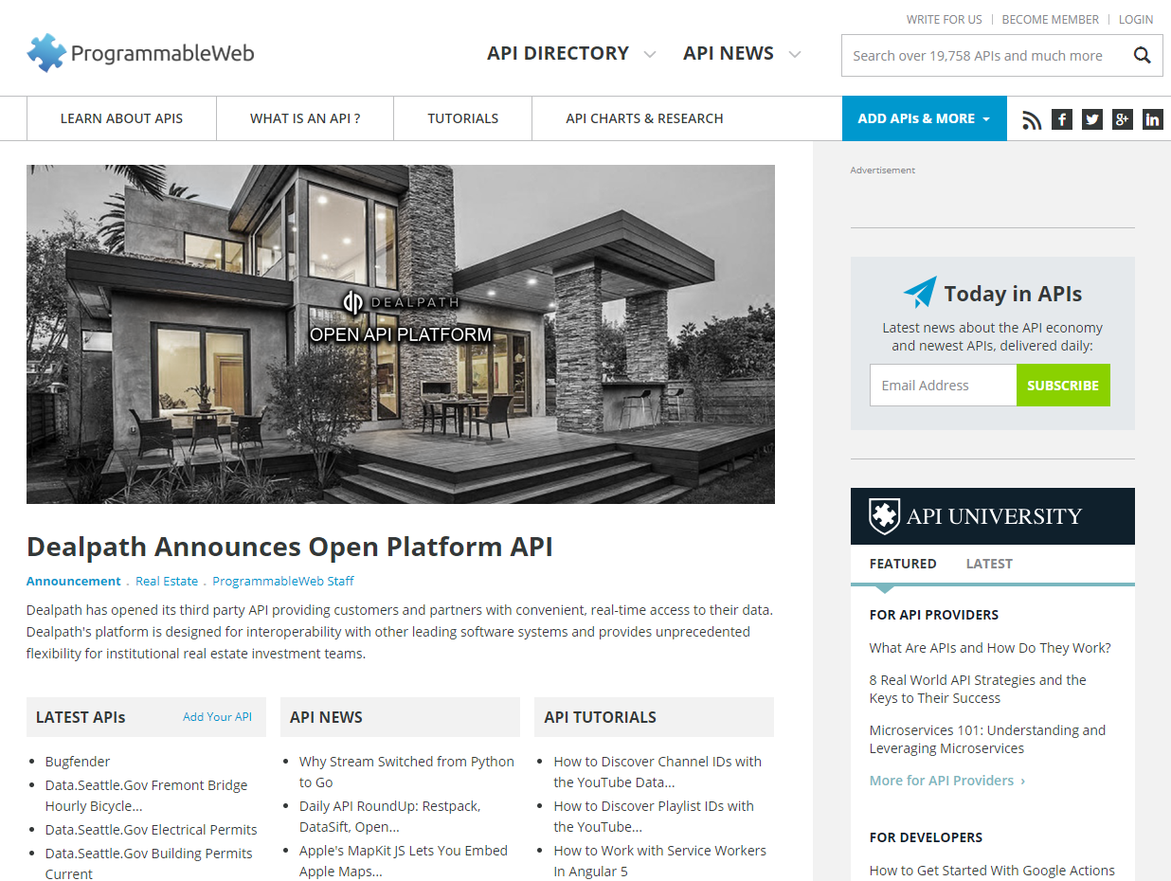
Use Web APIs to Empower Chorus
19,758+ APIS
Notes:
We think of Web APIs.
This page shows the ProgrammableWeb, a web site that collects Web APIs.
Nowadays, it contains 16 thousands of Web APIs.
We have a lot of them.
they are well-defined.
And a lot of them are even free.

Slide 58
Use Web APIs to Empower Chorus
19,758+ APIS
How to convert an Web API into a chatbot?
Notes:
We think of Web APIs.
This page shows the ProgrammableWeb, a web site that collects Web APIs.
Nowadays, it contains 16 thousands of Web APIs.
We have a lot of them.
they are well-defined.
And a lot of them are even free.

Slide 59
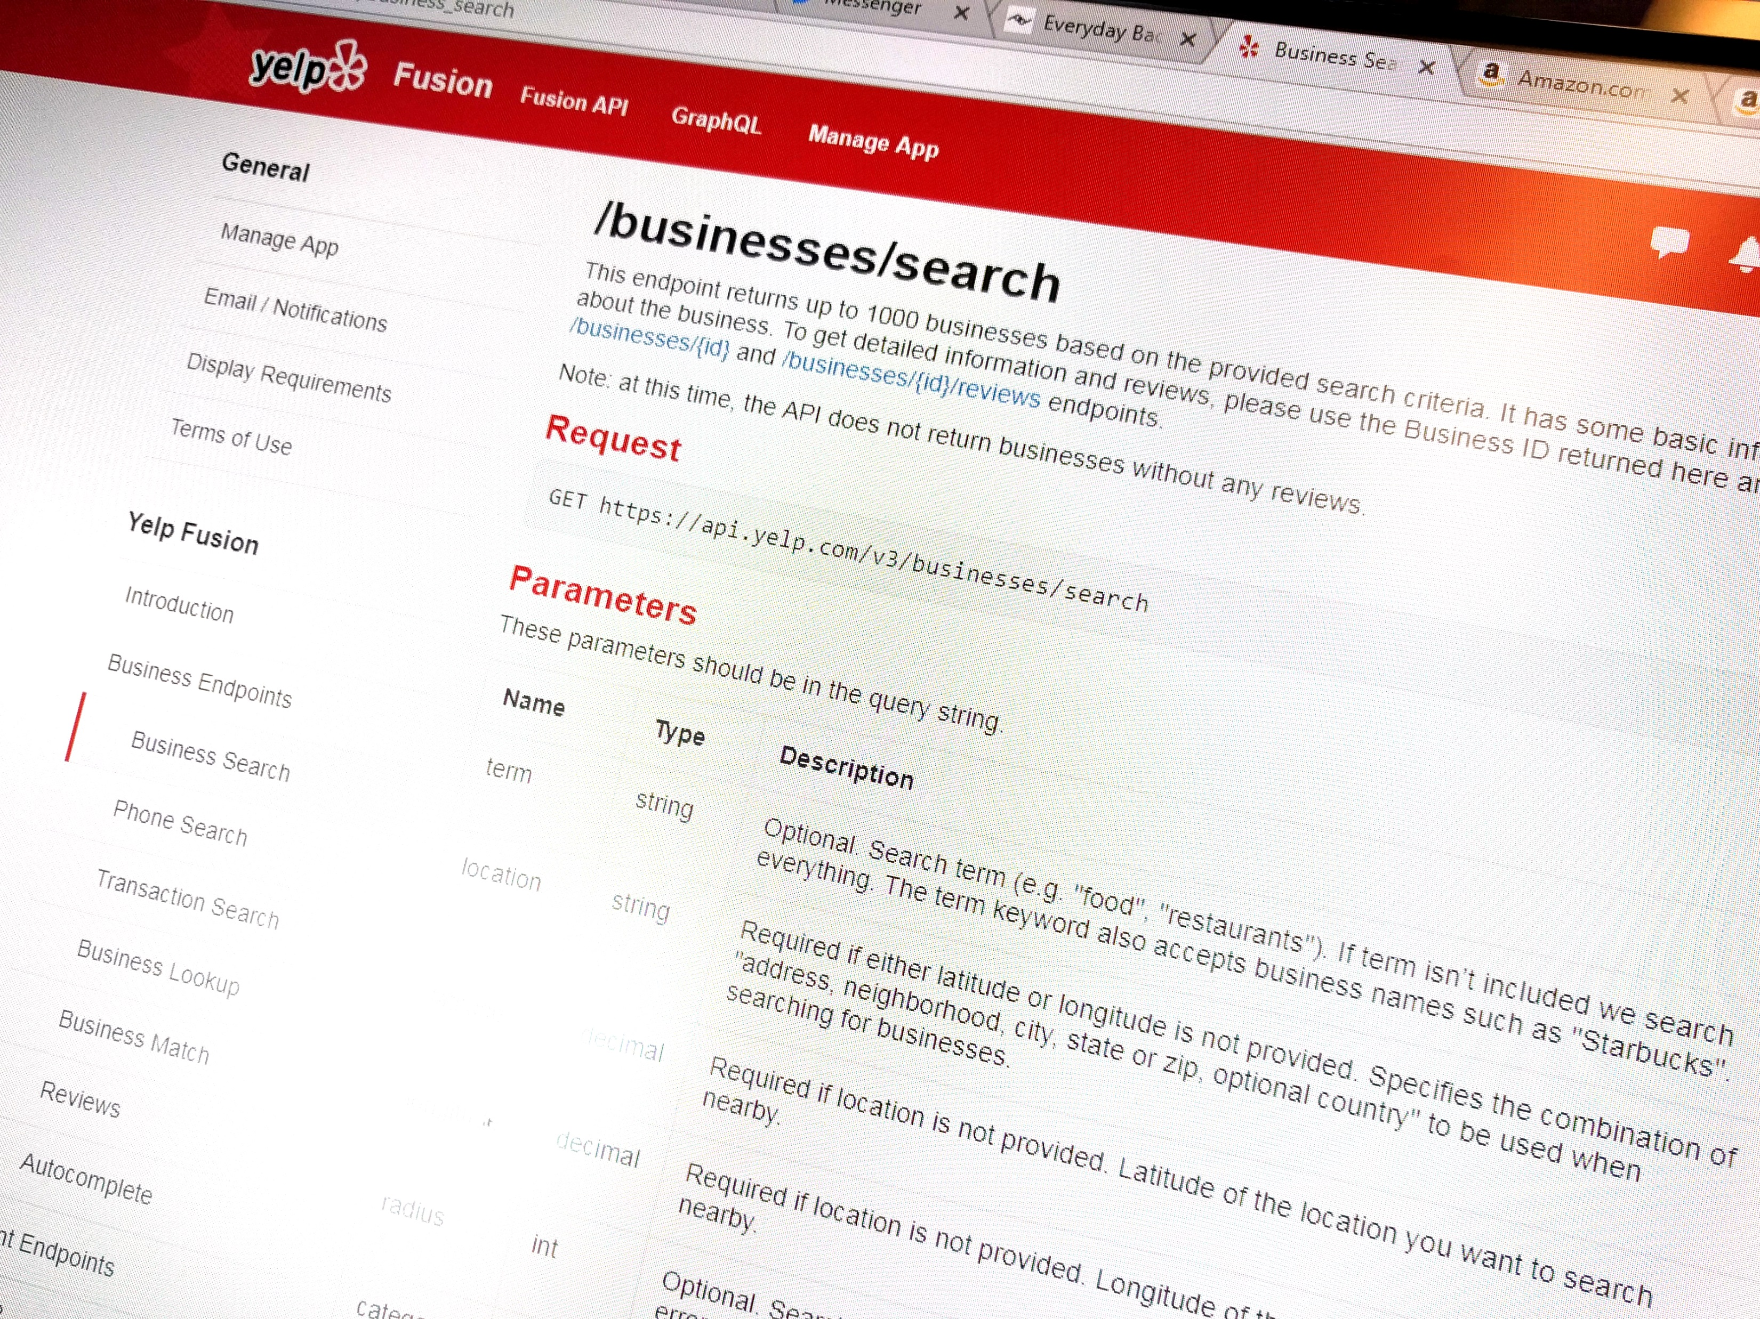
Guardian: A Crowd-Powered Spoken Dialog System for Web APIs [ HCOMP WIP’14, HCOMP’15, CI’17 ]

Slide 60



Guardian: A Crowd-Powered Dialog System for Web APIs
1
Language Understanding
Hi, I’m in San Diego.
Any Chinese restaurants here?
2
Dialog Management
location = San Diego
term = Chinese
JSON
{ ... "name": "Mandarin Wok Restaurant”,... "address":["4227 Balboa Ave”,...], …}
3
Response Generation
Yelp Search API 2.0
Mandarin Wok Restaurant is good ! It’s on 4227 Balboa Ave.
Notes:
Guaridan’s framework contains three main steps:
First, the workers have a conversation with the user, and extract the parameter values with a dialog ESP Game.
Second, behind the scenes, the system will us these values to call the Yelp API and run the query.
Finally, when Yelp API returns the result, it’s in a JSON file. We also use the crowd to interpret the response.
We visualize the JSON file as a user friendly interface. The workers can click through the data and explore the information inside the JSON.
By using Guardian, we can have a running dialog system without using any training data or even pre-knowledge of task.

Slide 61

Parameter Extraction
Hi, I’m in San Diego.
Any Chinese restaurants here?
Parameters
offset
term
location
sw_latitude
Yelp
Search
API
category_filter
sw_longitude
radius_filter
User
deals_filter
accuracy
...
Notes:
How to choose parameters?
We think of this problem as a Parameter Rating Problem.
Imagine you have a list of all parameters of Yelp API.
The task is to rate how good is each parameter for dialog systems.
The output is the rating score attached to each parameter, and thus you can have a ranking list of all parameters.

Slide 62
Parameter Extraction
Hi, I’m in San Diego.
Any Chinese restaurants here?
Parameters
offset
term
location
1. How to extract parameters?
sw_latitude
Yelp
Search
API
category_filter
sw_longitude
radius_filter
User
2. Which parameters
to use?
deals_filter
accuracy
...
Notes:
How to choose parameters?
We think of this problem as a Parameter Rating Problem.
Imagine you have a list of all parameters of Yelp API.
The task is to rate how good is each parameter for dialog systems.
The output is the rating score attached to each parameter, and thus you can have a ranking list of all parameters.

Slide 63
How to Extract Parameters?
Hi, I’m in San Diego.
Any Chinese restaurants here?
Parameters
offset
term
location
1. How to extract parameters?
sw_latitude
Yelp
Search
API
category_filter
sw_longitude
radius_filter
User
2. Which parameters
to use?
deals_filter
accuracy
...
Notes:
How to choose parameters?
We think of this problem as a Parameter Rating Problem.
Imagine you have a list of all parameters of Yelp API.
The task is to rate how good is each parameter for dialog systems.
The output is the rating score attached to each parameter, and thus you can have a ranking list of all parameters.

Slide 64

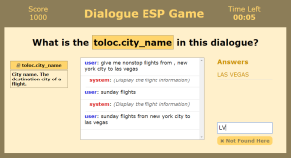
Crowd-Powered Parameter Extraction
Hi, I’m in San Diego.
Answer
Aggregate
Location =
San Diego
Recruited Players
Time Constraint
(10 – 20 sec)
Real-time On-Demand Crowd-powered Entity Extraction.
Huang, et al. Collective Intelligence 2017.
Notes:
We propose a multi-player Dialog ESP Game to extract parameter values from a running conversation.
ESP Game is originally proposed for image labeling, now we adopt the idea to dialog.
In the interface, we show the dialog, we show the description of the parameter, and ask the workers to type what the other workers might type
If there are two answers matching with each other, we take it as the extracted parameter value.
This method works well. Now we can extract parameters without having any training data.
Therefore, based on all the works we’ve done, we propose a system called “Guardian”:
There are 2 ways to aagregate the answers.

Slide 65
Which Parameters to Use?
Hi, I’m in San Diego.
Any Chinese restaurants here?
Parameters
offset
term
location
1. How to extract parameters?
sw_latitude
Yelp
Search
API
category_filter
sw_longitude
radius_filter
User
2. Which parameters
to use?
deals_filter
accuracy
...
Notes:
How to choose parameters?
We think of this problem as a Parameter Rating Problem.
Imagine you have a list of all parameters of Yelp API.
The task is to rate how good is each parameter for dialog systems.
The output is the rating score attached to each parameter, and thus you can have a ranking list of all parameters.

Slide 66
Parameter Rating Problem
Pick good parameters for the dialog system.
offset
offset
term
term
location
location
sw_latitude
sw_latitude
category_filter
category_filter
sw_longitude
sw_longitude
radius_filter
radius_filter
deals_filter
deals_filter
accuracy
accuracy
...
...
Notes:
How to choose parameters?
We think of this problem as a Parameter Rating Problem.
Imagine you have a list of all parameters of Yelp API.
The task is to rate how good is each parameter for dialog systems.
The output is the rating score attached to each parameter, and thus you can have a ranking list of all parameters.

Slide 67
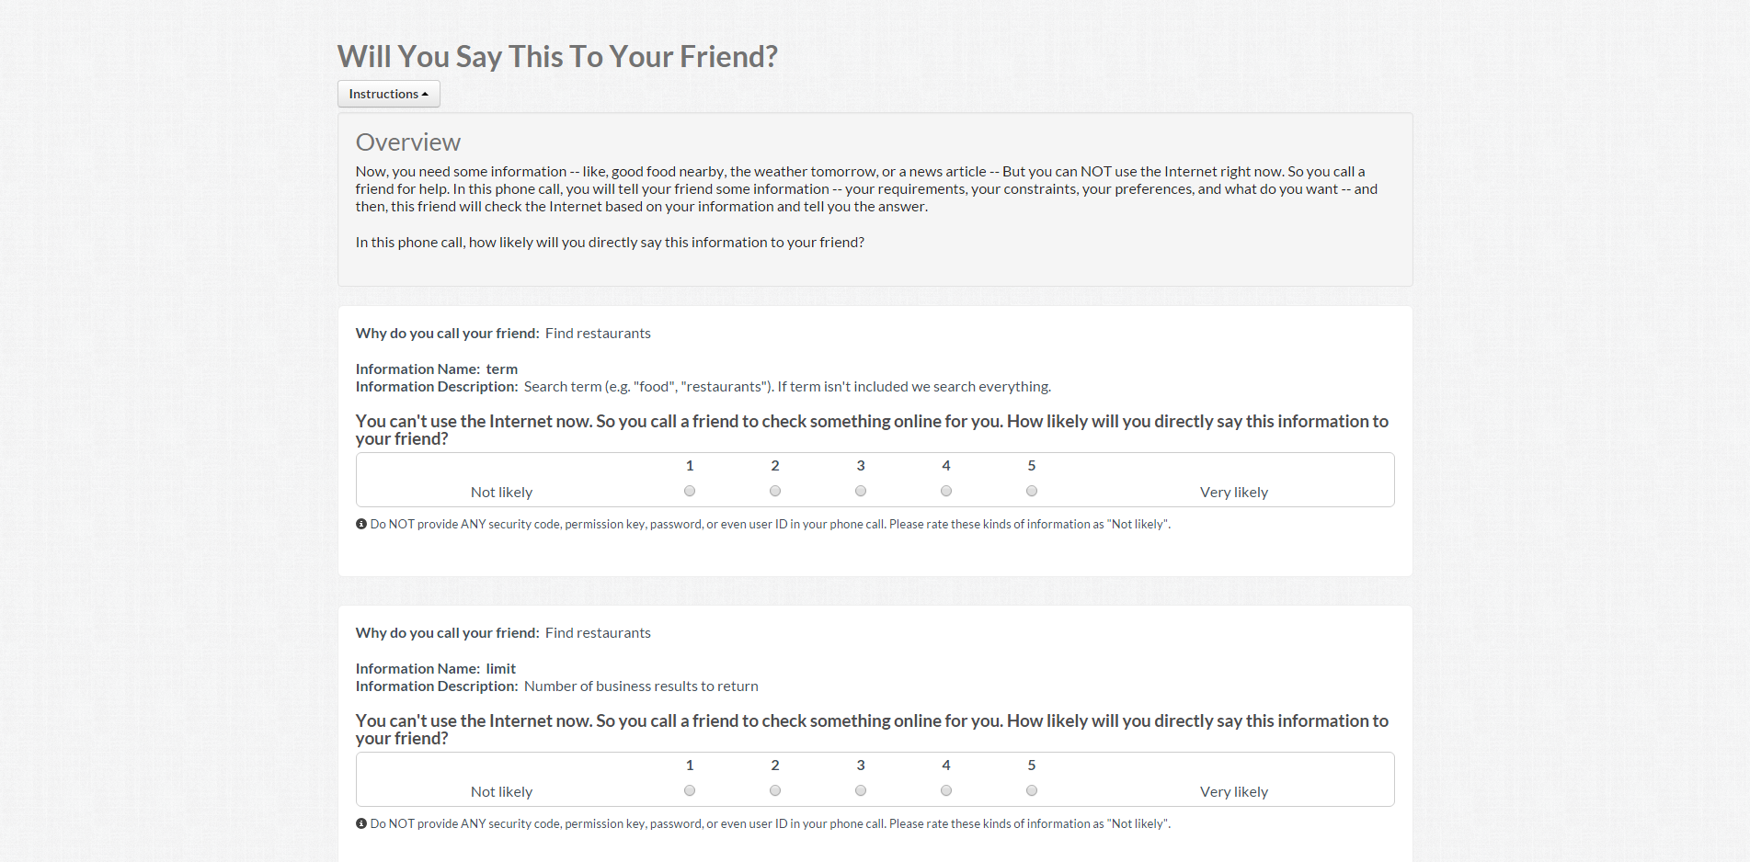
How about just do a survey?
Task
Parameter Name / Desc
Notes:
As a crowdsourcing person, people would ask: Why don’t you just tell the crowd what you want and do a survey on each parameters?
So we did.
This is our interface. This survey is conducted on CrowdFlower.
For each parameter, we show the parameter name, parameter’s description, and the task of the API.
Then we ask the worker to imagine a scenario, and rate how likely you are going to provide the information of this parameter as a user.
To be more careful, we run experiment on three different scenarios.
First, ask Siri. Imagine you’re talking to Siri, how likely you’re going to provide this information?
Second, as a friend. Imagine you can not use Internet right now and call a friend for help, how likely you’re going to provide this information?
Third, we also ask the workers to rate how wired is the parameter, and use “Not Weird” as rating.
How does this work?

Slide 68

Match Questions with Parameters
Question Collection
?
What do you want to eat?
!
I like Chinese food.
?
Which city are you in?
!
I’m in Pittsburgh.
?
Is it dinner or lunch?
!
...
Dinner.
Yelp API
Notes:
Like this!
The ideas we propose here is to collect questions related to this task, and then ask the workers use questions to vote for parameters.
Take the Yelp API for example, we first collect all possible questions from the crowd.
Like “what do you want to eat?”, “where are you?”, “What’s your budget?”and so on.
And then we ask workers to associate questions with parameters.
So essentially, the workers are using questions to vote for parameters.
We assume the parameters that are associated with more questions are better for dialog systems.
How does this work?

Slide 69
Match Questions with Parameters
Question Collection
?
What do you want to eat?
!
I like Chinese food.
?
Which city are you in?
!
I’m in Pittsburgh.
?
Is it dinner or lunch?
!
...
Dinner.
Parameter Filtering
Yelp API
offset
term
location
sw_latitude
sw_longitude
category_filter
Notes:
Like this!
The ideas we propose here is to collect questions related to this task, and then ask the workers use questions to vote for parameters.
Take the Yelp API for example, we first collect all possible questions from the crowd.
Like “what do you want to eat?”, “where are you?”, “What’s your budget?”and so on.
And then we ask workers to associate questions with parameters.
So essentially, the workers are using questions to vote for parameters.
We assume the parameters that are associated with more questions are better for dialog systems.
How does this work?

Slide 70
Match Questions with Parameters
Question Collection
Question-Parameter Matching
?
What do you want to eat?
!
?
?
?
?
I like Chinese food.
?
?
?
?
!
!
!
!
!
!
!
!
?
Which city are you in?
?
category_filter
?
!
?
!
I’m in Pittsburgh.
!
?
!
?
?
?
?
?
?
?
Is it dinner or lunch?
?
?
?
?
?
!
!
!
!
!
!
!
!
!
...
!
!
!
Dinner.
!
Parameter Filtering
?
?
?
?
!
!
?
Yelp API
!
!
?
term
!
offset
Better Parameter
!
?
?
?
!
?
?
term
!
!
!
!
!
location
?
?
?
!
sw_latitude
location
!
!
sw_longitude
?
?
?
?
!
!
!
!
category_filter
Notes:
?/! -> Q/A
Like this!
The ideas we propose here is to collect questions related to this task, and then ask the workers use questions to vote for parameters.
Take the Yelp API for example, we first collect all possible questions from the crowd.
Like “what do you want to eat?”, “where are you?”, “What’s your budget?”and so on.
And then we ask workers to associate questions with parameters.
So essentially, the workers are using questions to vote for parameters.
We assume the parameters that are associated with more questions are better for dialog systems.
How does this work?

Slide 71







Evaluation on Parameter Ranking
Average results of 8 Web APIs’ parameters
Notes:
What does it mean to be better?! Retrieve parameters better than a friend
Other than question-matching approaching
It turned out our workflow outperforms all three baselines.
When you take a look at the result, you will know the quality is much better and close to practical use.

Slide 72
Guardian: A Crowd-Powered Dialog System for Web APIs
1
Language Understanding
Hi, I’m in San Diego.
Any Chinese restaurants here?
2
Dialog Management
location = San Diego
term = Chinese
JSON
{ ... "name": "Mandarin Wok Restaurant”,... "address":["4227 Balboa Ave”,...], …}
3
Response Generation
Yelp Search API 2.0
Mandarin Wok Restaurant is good ! It’s on 4227 Balboa Ave.
Notes:
Guaridan’s framework contains three main steps:
First, the workers have a conversation with the user, and extract the parameter values with a dialog ESP Game.
Second, behind the scenes, the system will us these values to call the Yelp API and run the query.
Finally, when Yelp API returns the result, it’s in a JSON file. We also use the crowd to interpret the response.
We visualize the JSON file as a user friendly interface. The workers can click through the data and explore the information inside the JSON.
By using Guardian, we can have a running dialog system without using any training data or even pre-knowledge of task.

Slide 73



Evaluation: Task Completion Rate
Task | Find Chinese restaurants in Pittsburgh. | Check current weather by using a zip code. | Find information of “Titanic”.
API Result | 9 out of 10 | 9 out of 10 | 6 out of 10
Final Response | 10 out of 10 | 9 out of 10 | 10 out of 10
2
Crowd Recover Errors
Crowd Recover Errors
3
Notes:
We implement the system on 3 different Web APIs.
Yelp API for restaurant search, Weather Underground API for weather query, and RottenTomatoes API for movie query.
We design three small tasks for each API, and run 10 trials on each systems.
Here we only talking about the task completion rate.
By task completion we mean the system provides the valid responses that contains the information the user requires.
You can see the task completion rate is almost perfect.
It’s because, first, the task here is relatively simple, second, even when the results returned from the API is incorrect, most of the time, crowd workers is able to figure it out the recover the correct answers.
We also compare our result with the task completion rate reported by literature.
The numbers are not directly comparable, but you can still see that our system reaches the same level of task completion rate with automated systems.

Slide 74
Automated
AI-Powered Dialog Systems
Personal
Assistants
Guardian
[ HCOMP’15, CI’17 ]
Evorus
[ CHI’18 , UIST Poster’17 ]
Chorus Deployment
[ HCOMP’16, HCOMP’17 ]
Crowd-Powered
Dialog Systems
Open Conversation

Slide 75
Crowd Research is Critical
For Building Future Computer Systems.
Collect data to guide AI models
Accomplish tasks that are not yet fully automated
Pave the way for future AI systems

Slide 76
A Crowd-Powered
Conversational Assistant
That Automates Itself Over Time
Lecturer: Kenneth Huang
Pennsylvania State University
txh710@psu.edu
Mar 26, 2019

Slide 77
Backup Slides

Slide 78

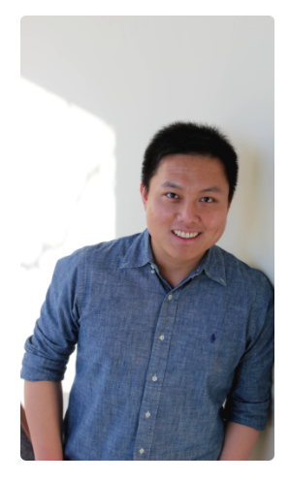
Thank you!
Ting-Hao (Kenneth) Huang
Pennsylvania State University
txh710@psu.edu
@windx0303
KennethHuang.cc

Slide 79
Notes:
How to automate….? Learning + voting

Slide 80
Automatic Voting

Slide 81
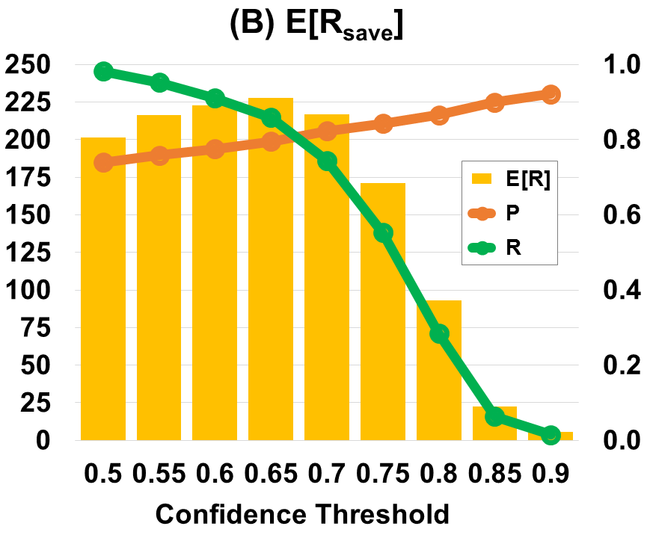
Find the Best Confidence Threshold
Expected Reward Points Saved

Slide 82
Thesis Statement
By allowing new chatbots to be easily integrated, reusing prior crowd answers, and gradually reducing the crowd's role in choosing high-quality responses, a deployed crowd-powered dialog system can be automated over time to support real-world open conversations.
Notes:
We introduce the new approach to open conversation

Slide 83
Thesis Statement
By allowing new chatbots to be easily integrated, reusing prior crowd answers, and gradually reducing the crowd's role in choosing high-quality responses, a deployed crowd-powered dialog system can be automated over time to support real-world open conversations.
Chorus Deployment
[ HCOMP’16, HCOMP’17 ]
Notes:
We introduce the new approach to open conversation

Slide 84
Thesis Statement
By allowing new chatbots to be easily integrated, reusing prior crowd answers, and gradually reducing the crowd's role in choosing high-quality responses, a deployed crowd-powered dialog system can be automated over time to support real-world open conversations.
Chorus Deployment
Evorus
[ HCOMP’16, HCOMP’17 ]
[ CHI’18 , UIST Poster’17 ]
Notes:
We introduce the new approach to open conversation

Slide 85
Thesis Statement
Guardian
[ HCOMP’15, CI’17 ]
By allowing new chatbots to be easily integrated, reusing prior crowd answers, and gradually reducing the crowd's role in choosing high-quality responses, a deployed crowd-powered dialog system can be automated over time to support real-world open conversations.
Chorus Deployment
Evorus
[ HCOMP’16, HCOMP’17 ]
[ CHI’18 , UIST Poster’17 ]
Notes:
We introduce the new approach to open conversation

Slide 86
Thesis Statement
By allowing new chatbots to be easily integrated, reusing prior crowd answers, and gradually reducing the crowd's role in choosing high-quality responses, a deployed crowd-powered dialog system can be automated over time to support real-world open conversations.
Notes:
We introduce the new approach to open conversation

Slide 87
Thesis Statement
Guardian
[ HCOMP’15, CI’17 ]
By allowing new chatbots to be easily integrated, reusing prior crowd answers, and gradually reducing the crowd's role in choosing high-quality responses, a deployed crowd-powered dialog system can be automated over time to support real-world open conversations.
Chorus Deployment
Evorus
[ HCOMP’16, HCOMP’17 ]
[ CHI’18 , UIST Poster’17 ]
Notes:
We introduce the new approach to open conversation

Slide 88
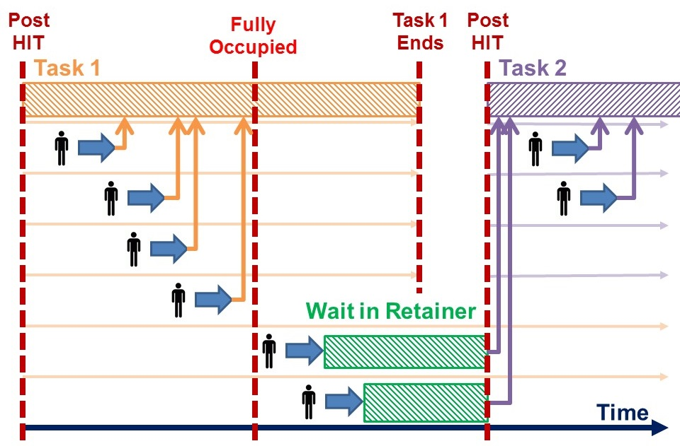
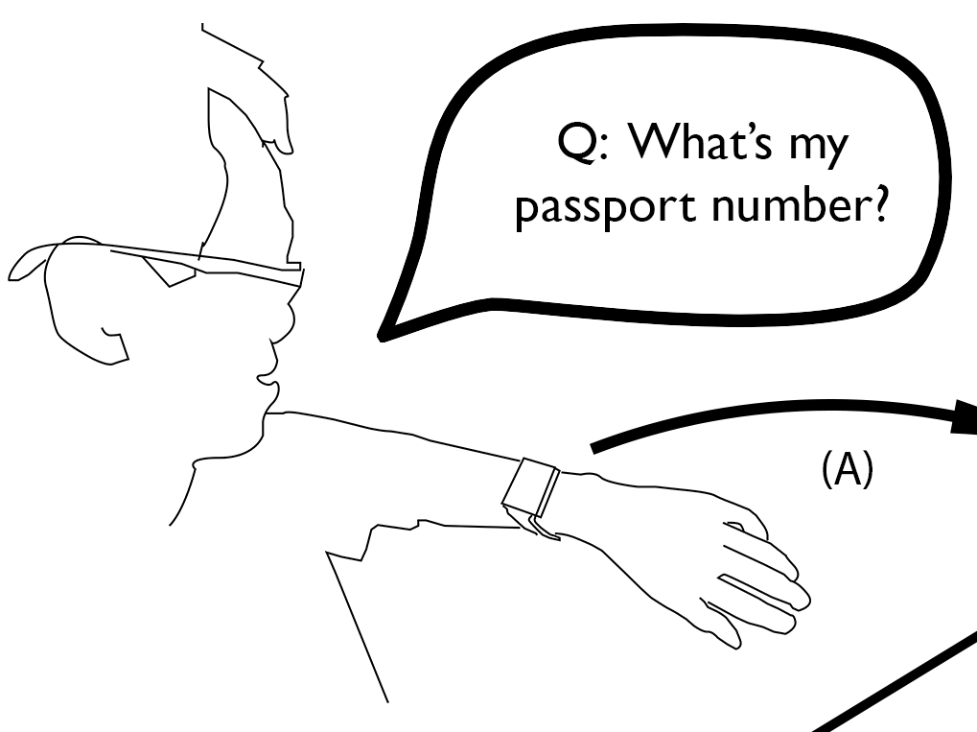
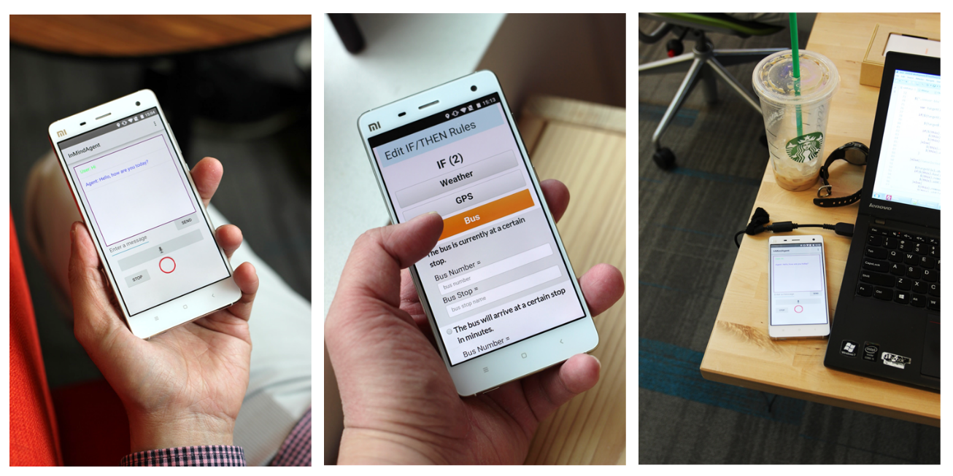
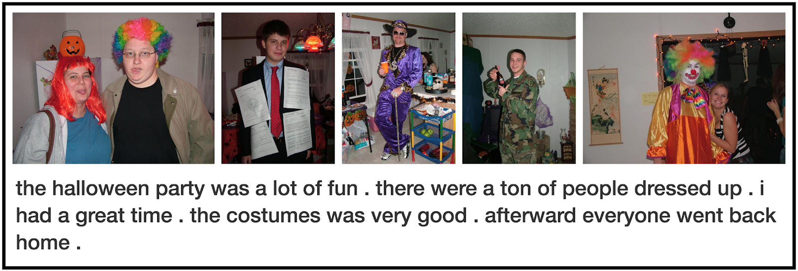
Some More Projects…
EmotionLines Chen et al., LREC’18
WearMail Swaminathan et al. UIST’17
Ignition HCOMP’17
InstructableCrowd
CHI LBW’16, TOCHI (Under Review)
Visual Storytelling (VIST) NAACL’16, Ferraro et al. EMNLP’15,

Slide 89
Future Work
Deployed Chorus as An Open Research Platform
Chorus API
1000+ chatbots
Chorus on Smart Devices
Echo, Google Home…
Future Crowd-AI Systems!
Object Recognition
Speech Recognition
Programming Tools
… And More!
Notes:
1. Leverage crowd wisdom to empower users to solve tasks which can not be solved by existing tech
2. Evorus demonstrates the potential of utilizing crowdsourced data as a scaffolding for training future AI systems
3. Pave the way for future AI systems to solve these problems

Slide 90

Future Work
Deployed Chorus as An Open Research Platform
Chorus API
1000+ chatbots
Chorus on Smart Devices
Echo, Google Home…
Future Crowd-AI Systems!
Object Recognition
Speech Recognition
Programming Tools
… And More!
( Fall 2018 )
Notes:
1. Leverage crowd wisdom to empower users to solve tasks which can not be solved by existing tech
2. Evorus demonstrates the potential of utilizing crowdsourced data as a scaffolding for training future AI systems
3. Pave the way for future AI systems to solve these problems

Slide 91
Acknowledgment
Family, Yan-Zhu (Lavender) Chen
Jeffrey P. Bigham
Walter S. Lasecki, Chris Callison-Burch, Alex Rudnicky, Margaret Mitchell, Lun-Wei Ku, Hsin-Hsi Chen, Saiph Savage, Jane Hsu…
Shoou-I Yu, Joseph Chee Chang, Chih-Yi (Jessica) Lin, Shihyun Lo, Chu-Cheng Lin, Yun-Nung (Vivian) Chen, Lingpeng Kong, Luan Yi, William Wang, Zi Yang, Yen-Chia Hsu, Kuen-Bang Hou (Favonia), Kerry Shih-Ping Chang, Janet Huang, Yi-Chia Wang, Kai-min Kevin Chang…
Anhong Guo, Sai Ganesh, Kotaro Hara, Yashesh Gaur, Gierad Laput, Robert Xiao, Yang Zhang, Patrick Carrington, Luz Rello, Cole Gleason, Kristin Williams, Alex Chen, Susumu Saito…
Amos Azaria, Oscar Romero Lopez…
Stacey Young

